Slide 1
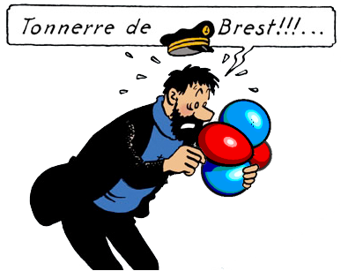
Protein docking with PCS restraints
Christophe Schmitz 29 September 2010

Slide 2
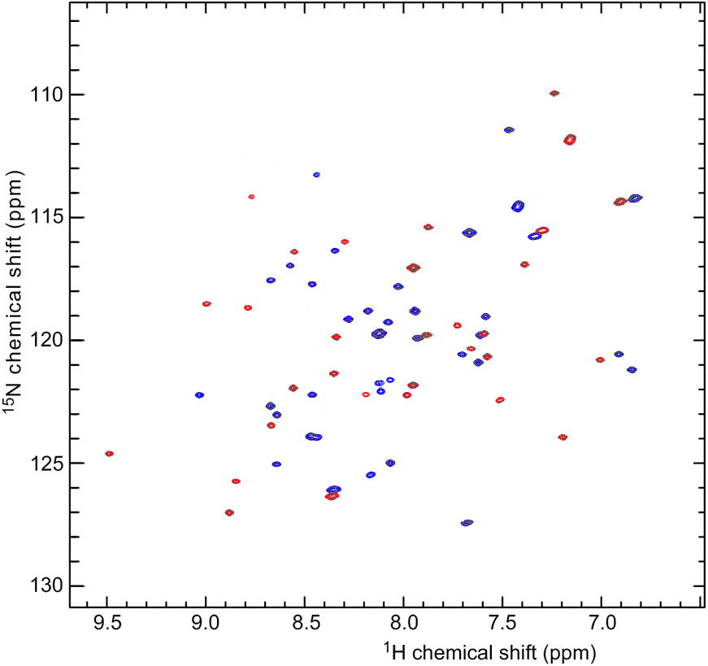
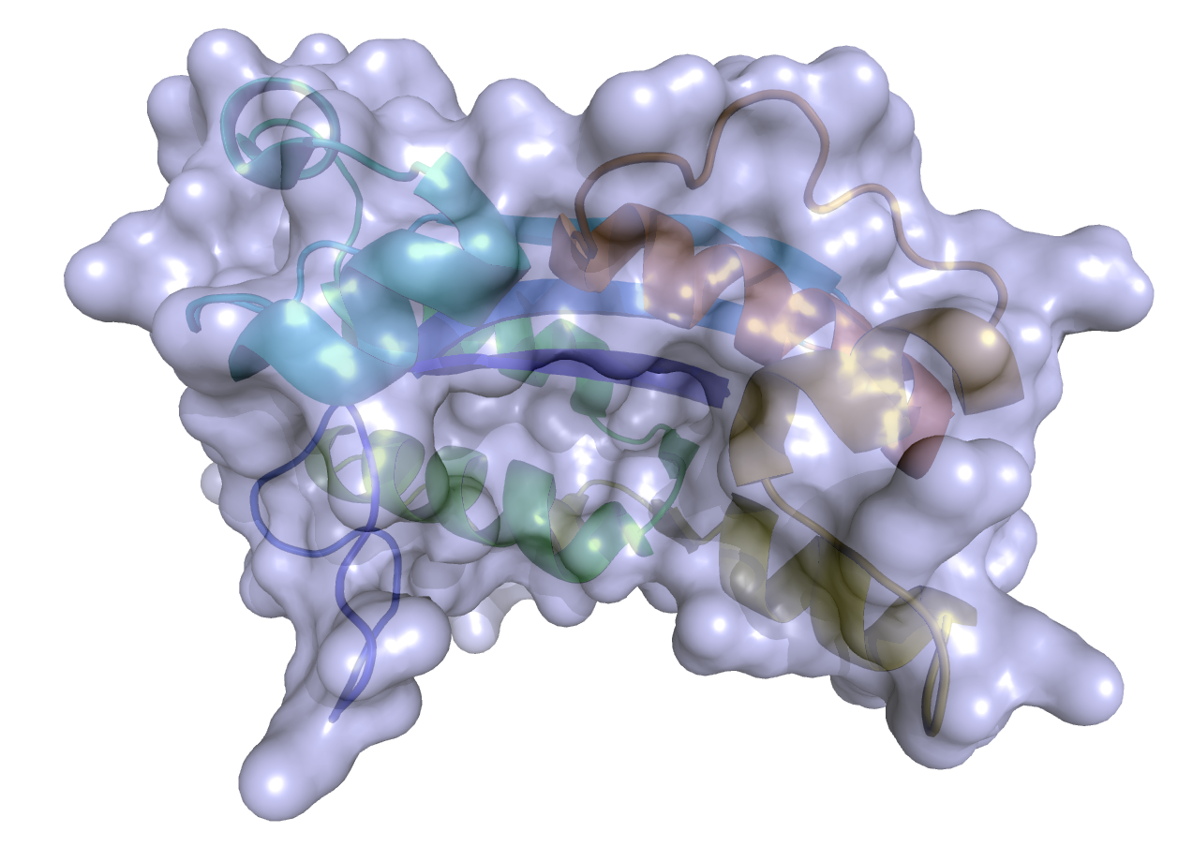
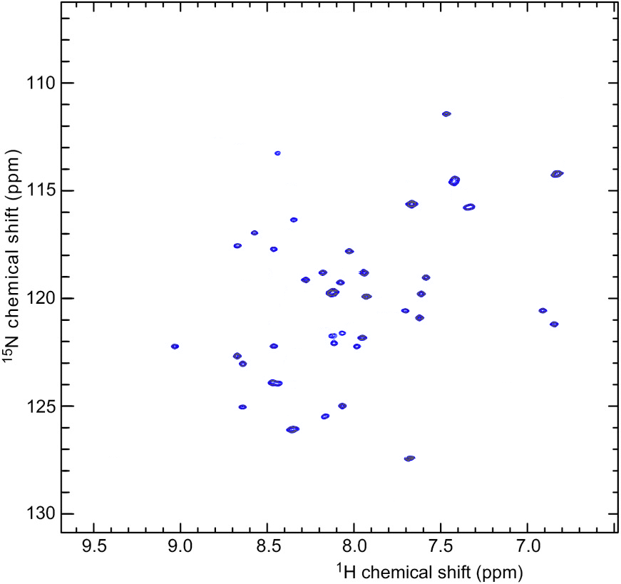
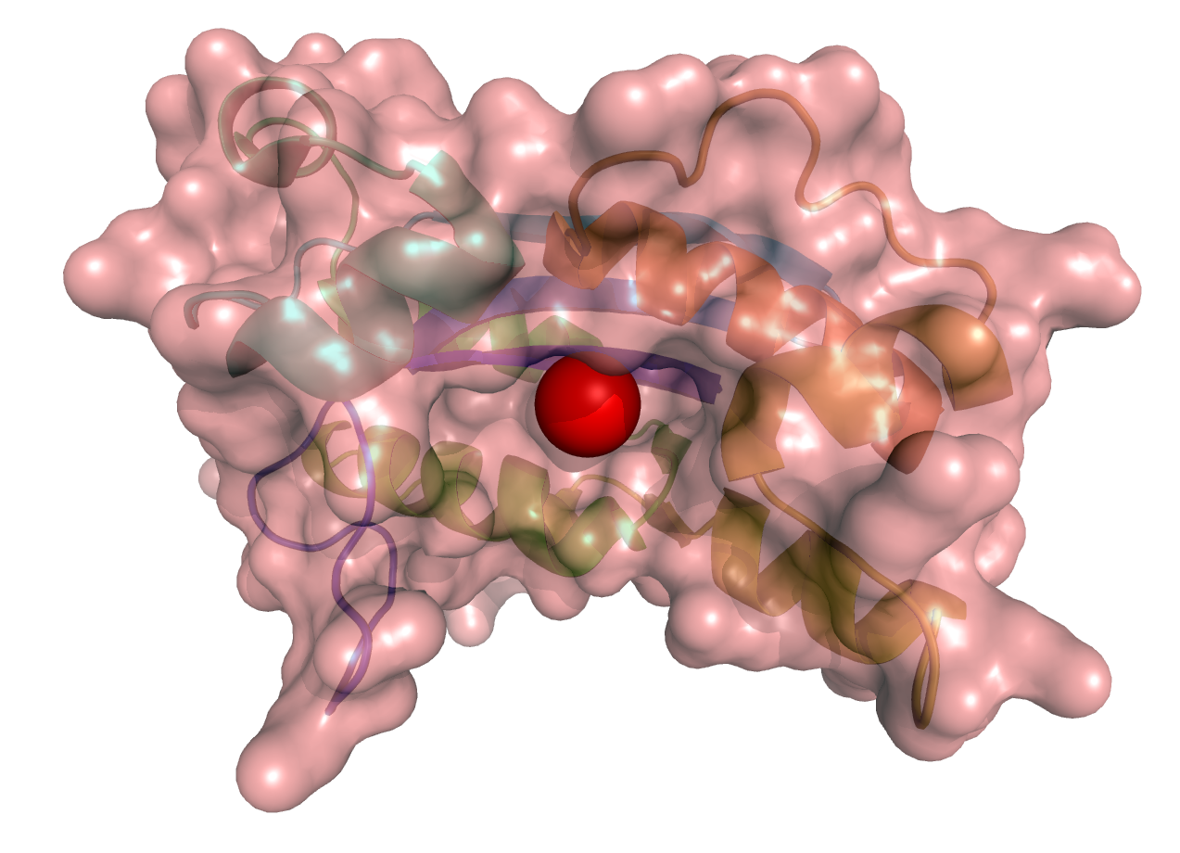
Paramagnetic restraints in Haddock: Pseudocontact shift (PCS)
PCS (N)
PCS (H)

Slide 3
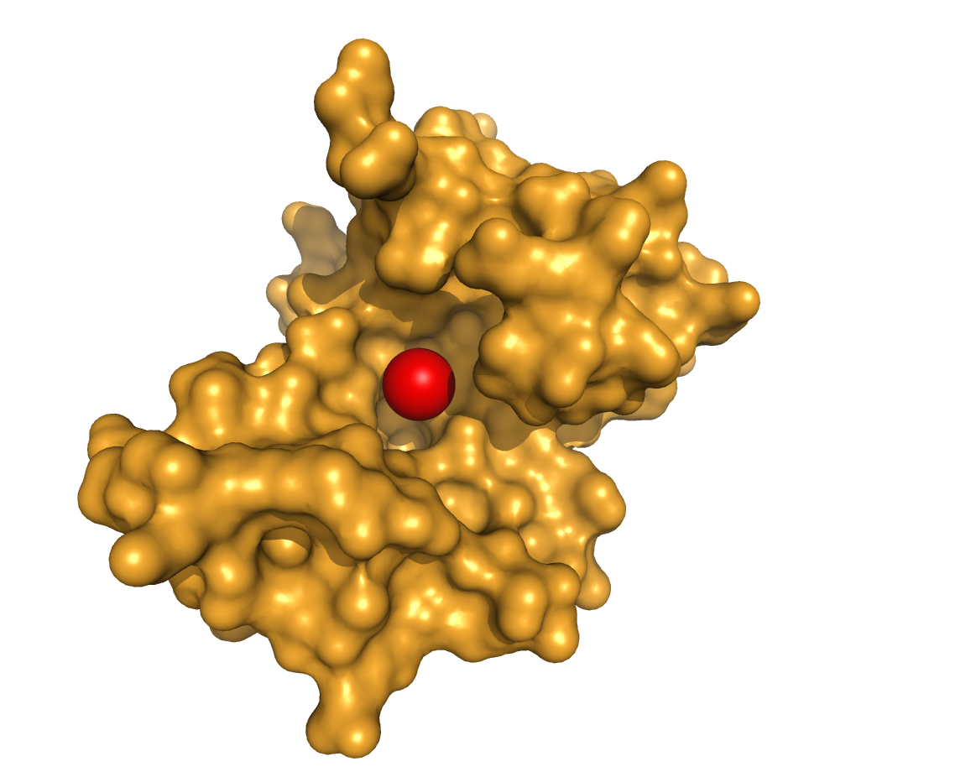
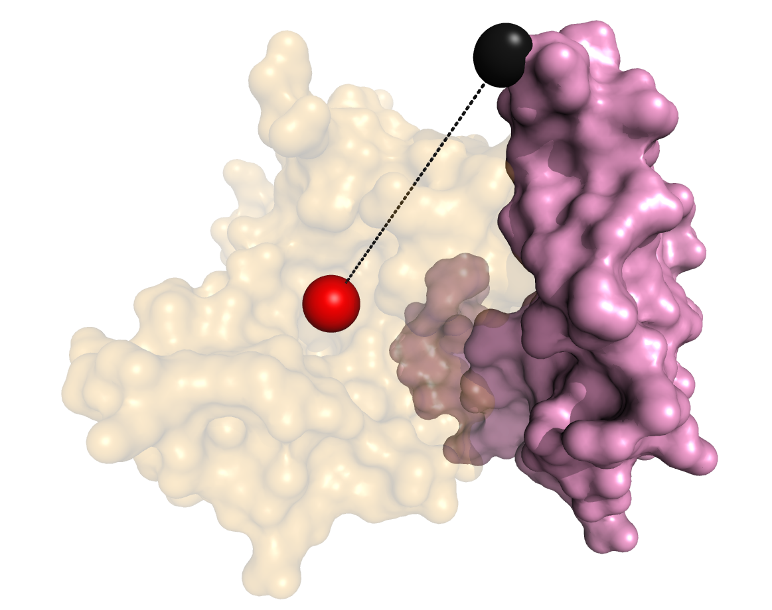
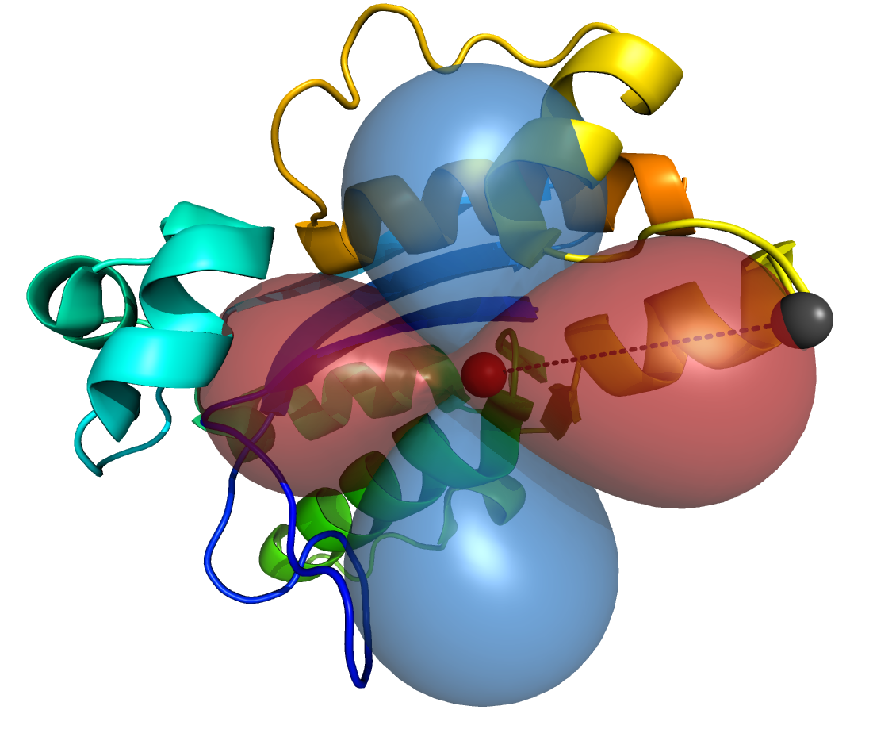
PCS for docking proteins
Atom coordinate in the protein frame
Δχ-tensor parameters
PCS(A34)= 1.2
PCS(H36)=-2.5
PCS(N50)=-0.1
…
PCS(V12)= 0.3
PCS(G36)=-0.2
PCS(V42)= 0.25
…

Slide 4
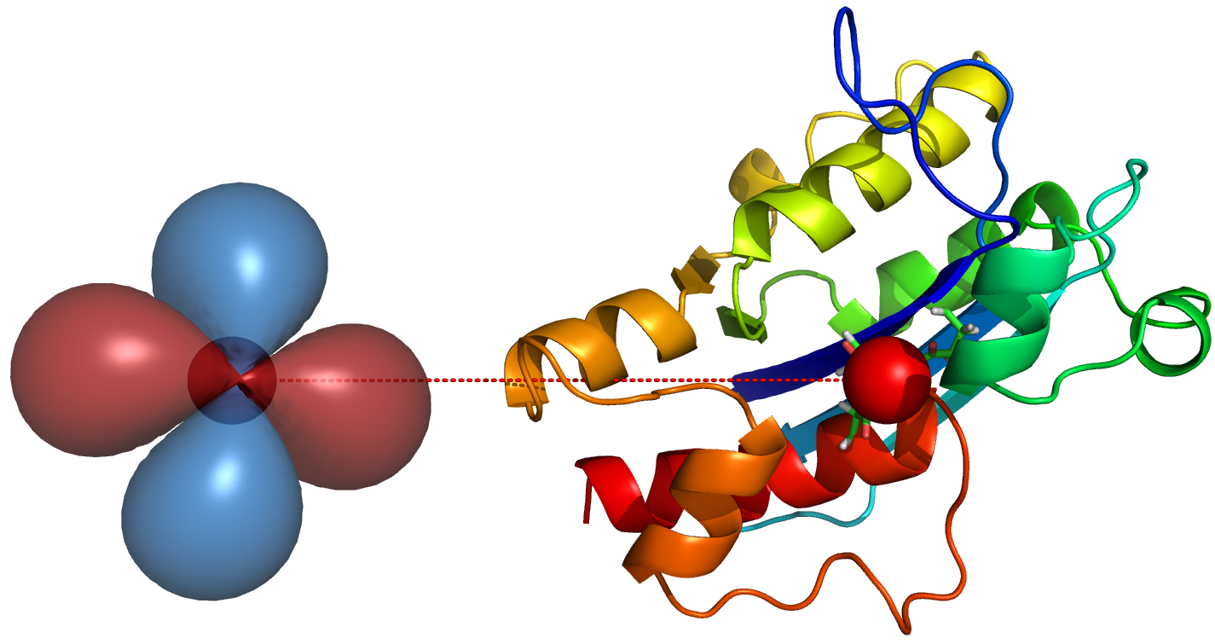
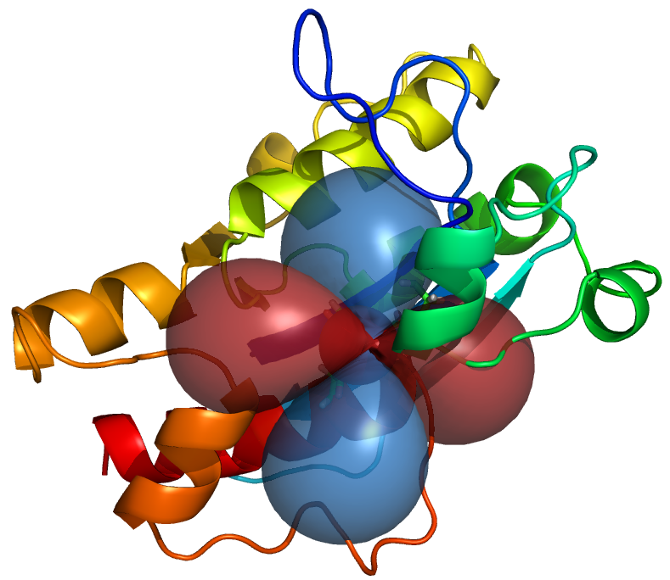
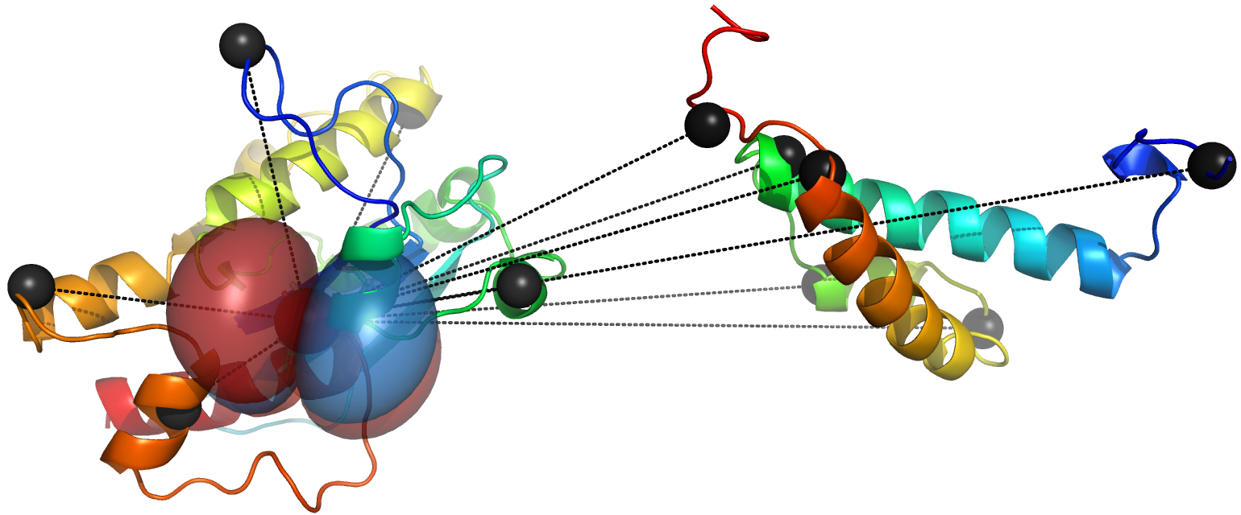
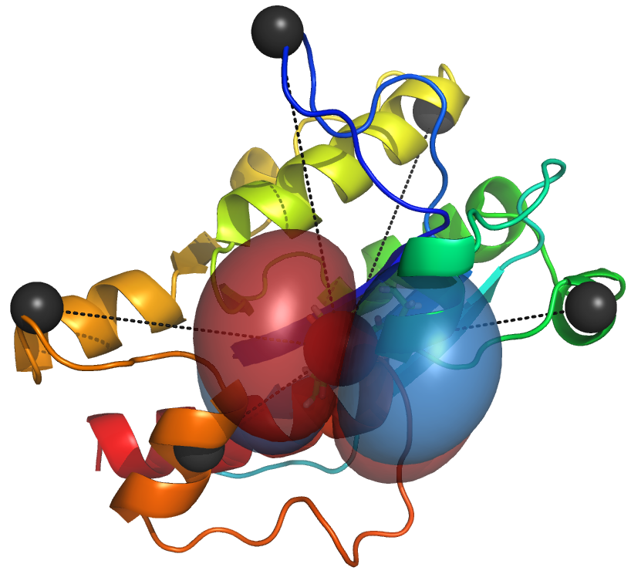
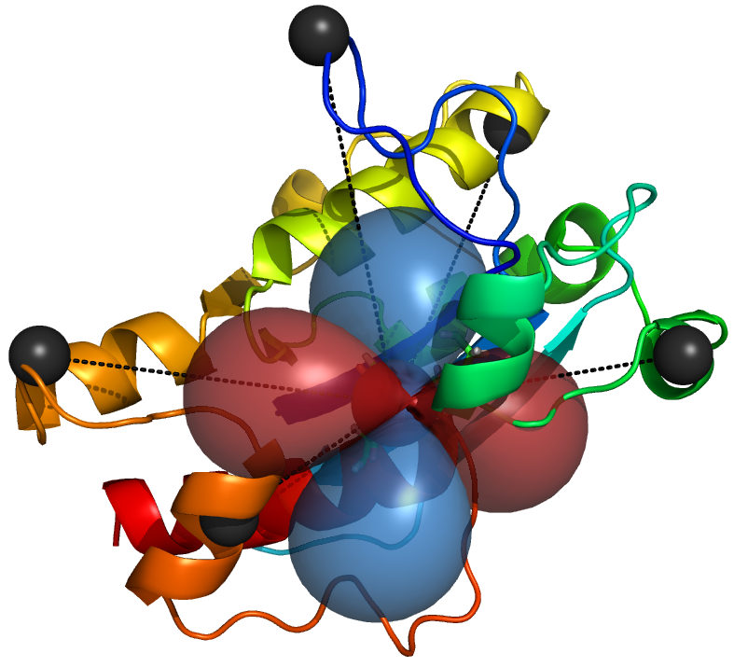
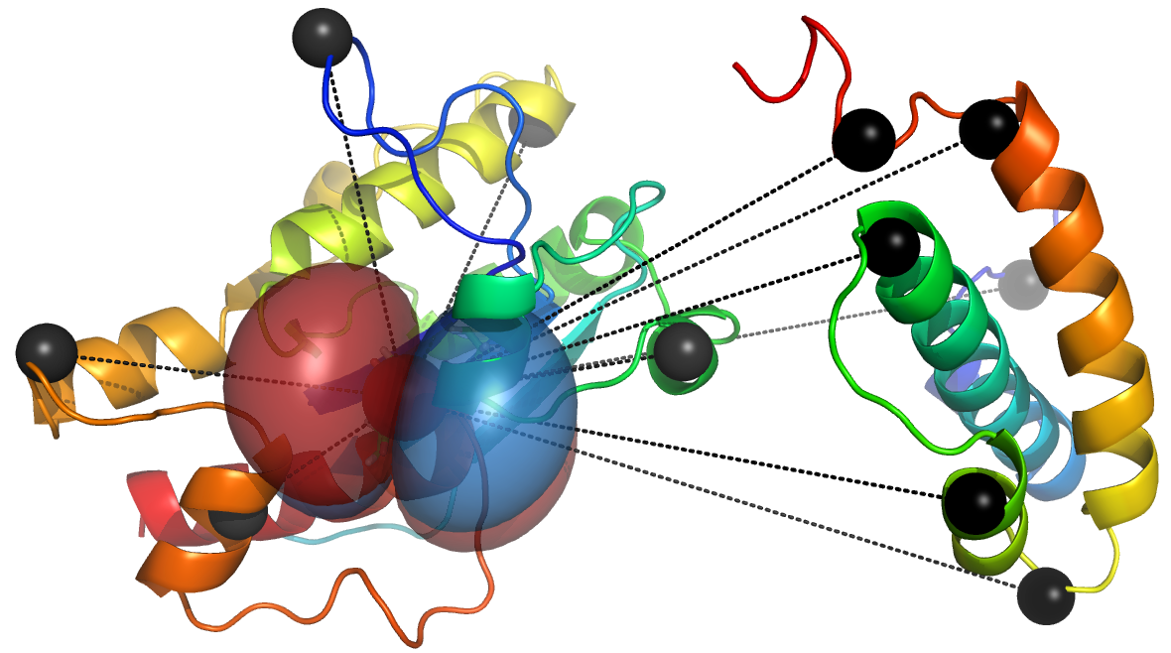
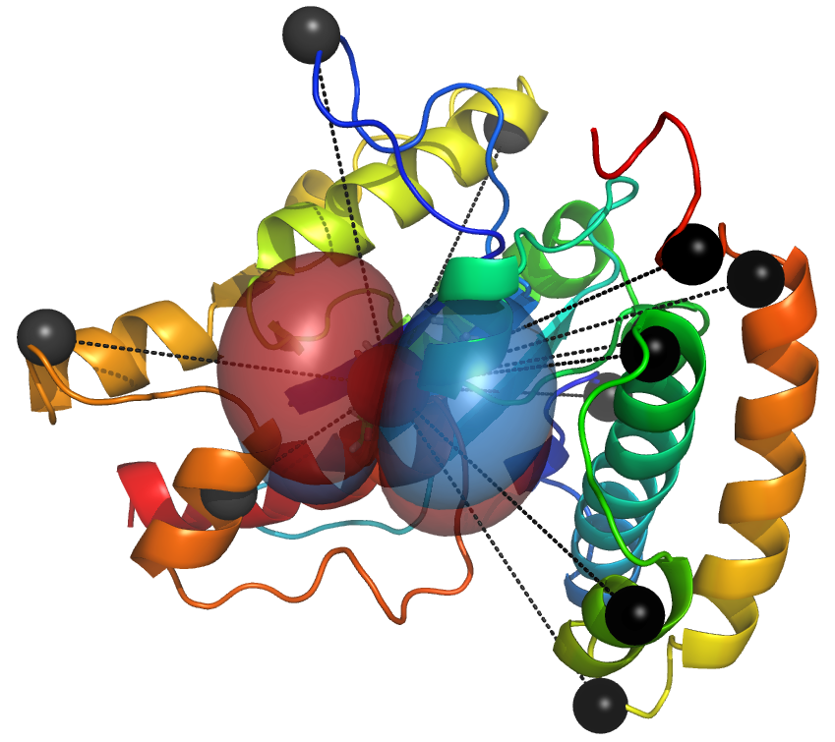
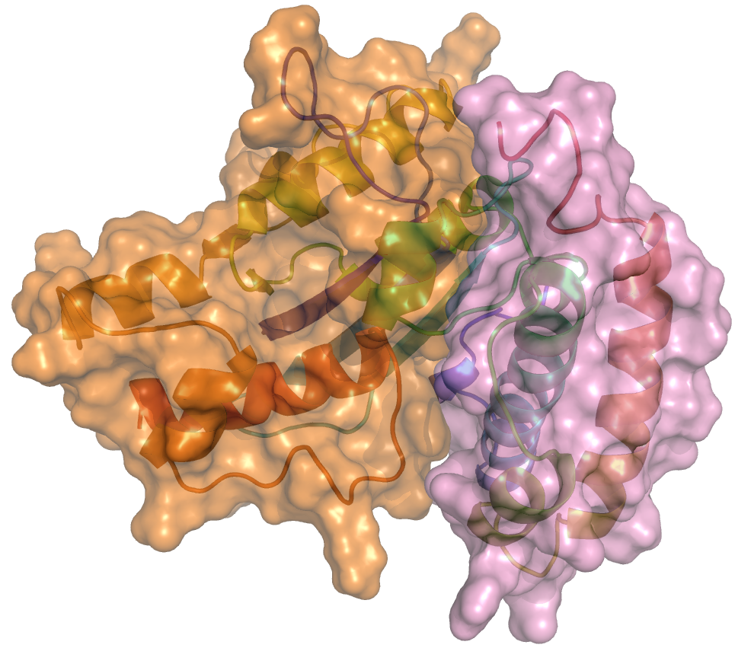
PCS-HADDOCK protocol

Slide 5
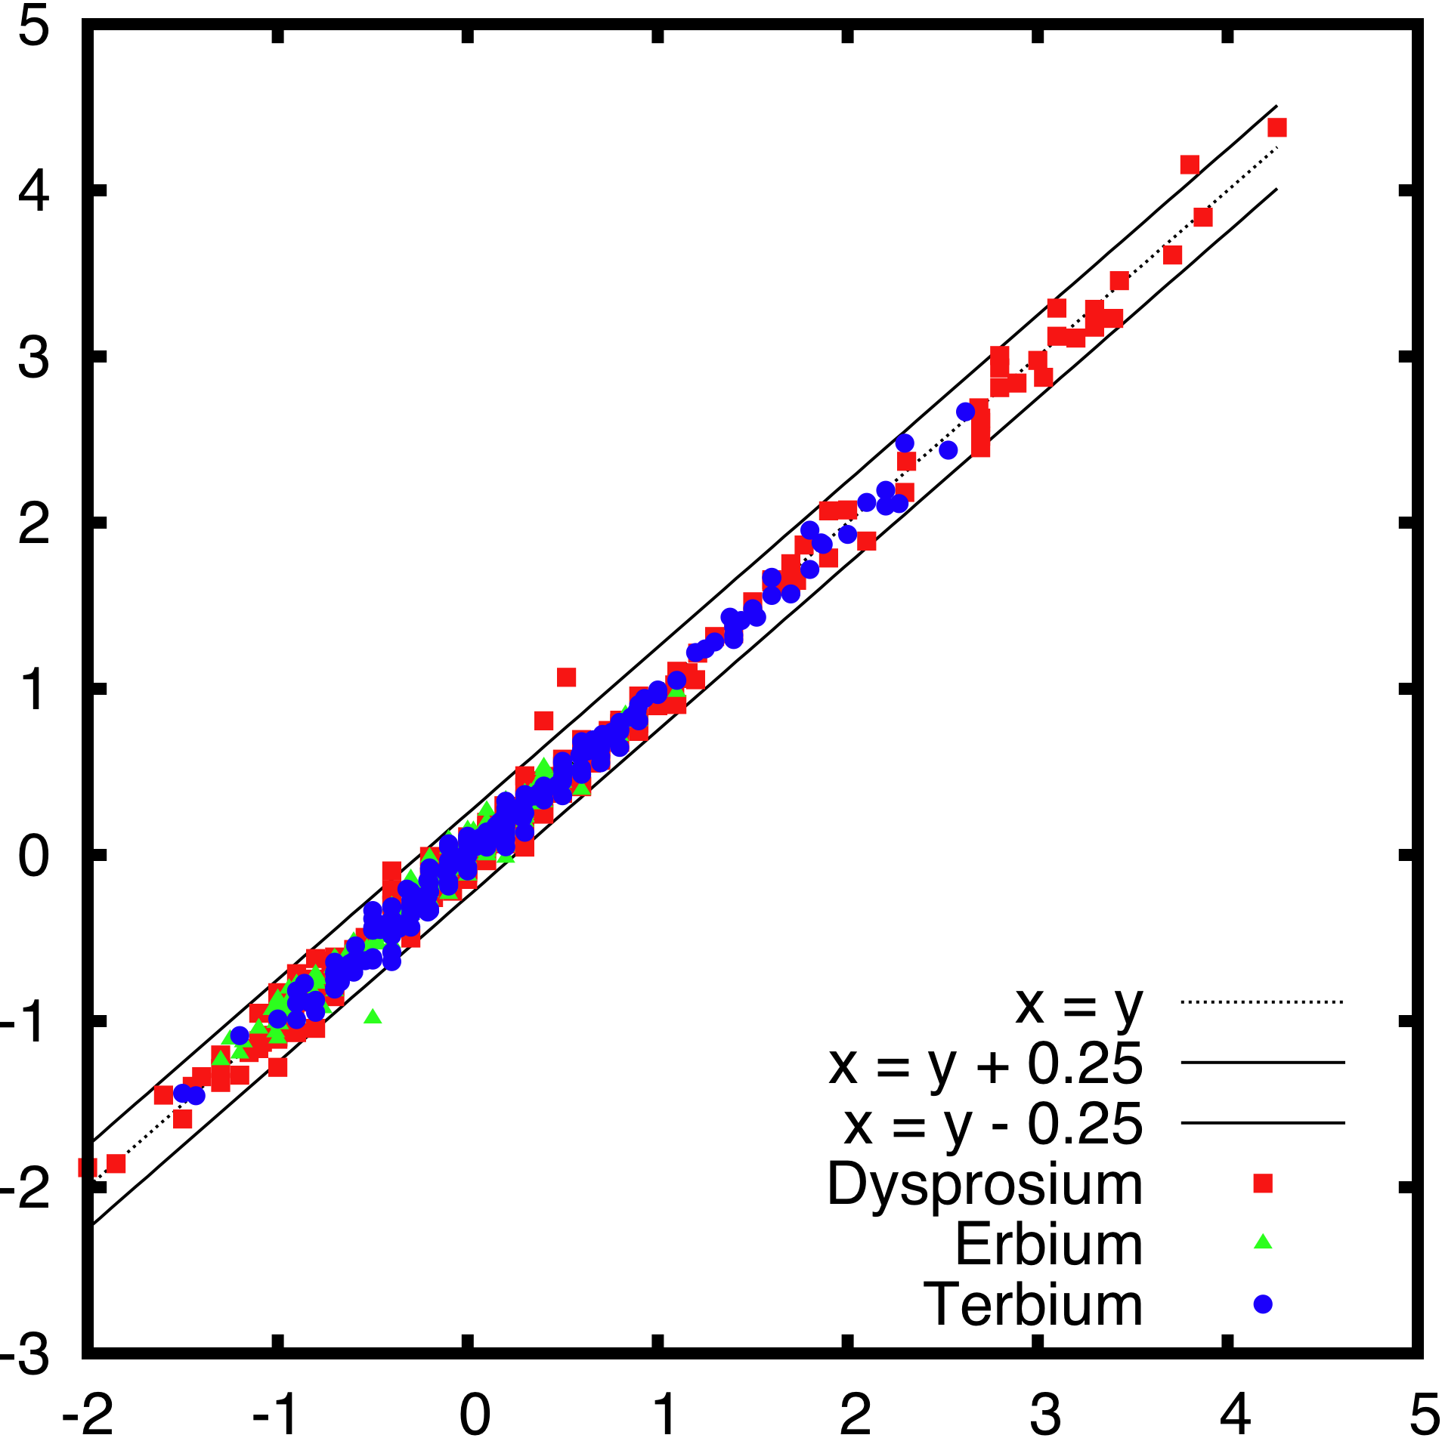
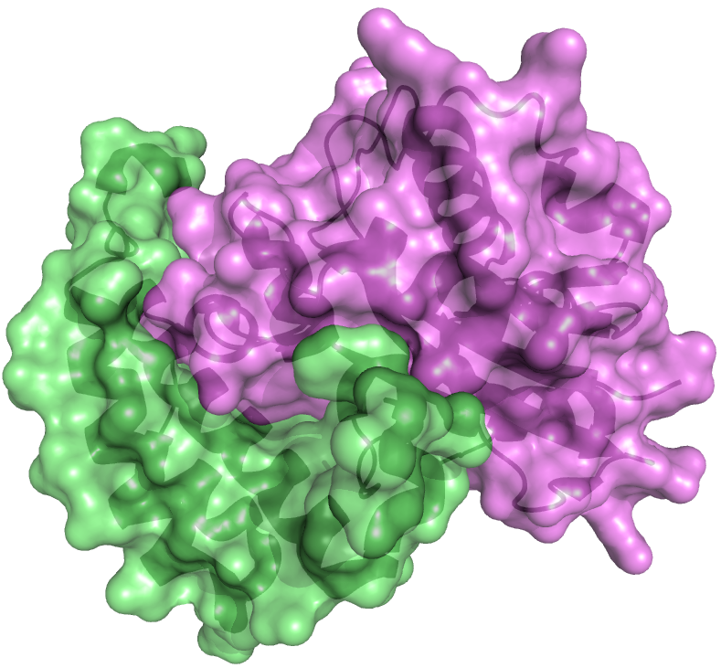
Synthetic data for protocol validation
Measured PCS [ppm]
Calculated PCS [ppm]
ε-HOT (2IDO)
Kirby et all. J. Biol. Chem. 2006
Realistic synthetic data:
Random variation of PCS (±0.15ppm)
Removal of some PCS

Slide 6
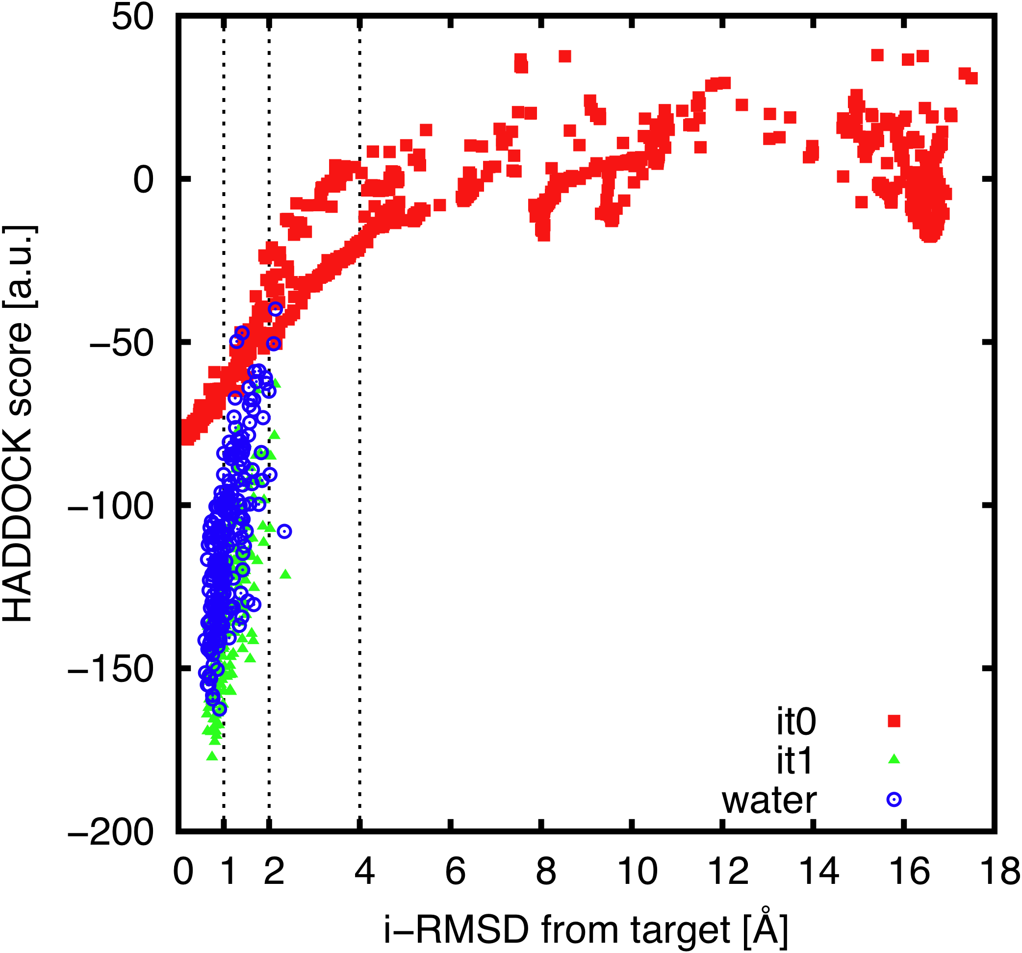
PCS-HADDOCK “synthetic results”: bound-bound case
Bound-bound docking

Slide 7
With more noise?
0.15 ppm
0.45 ppm

Slide 8
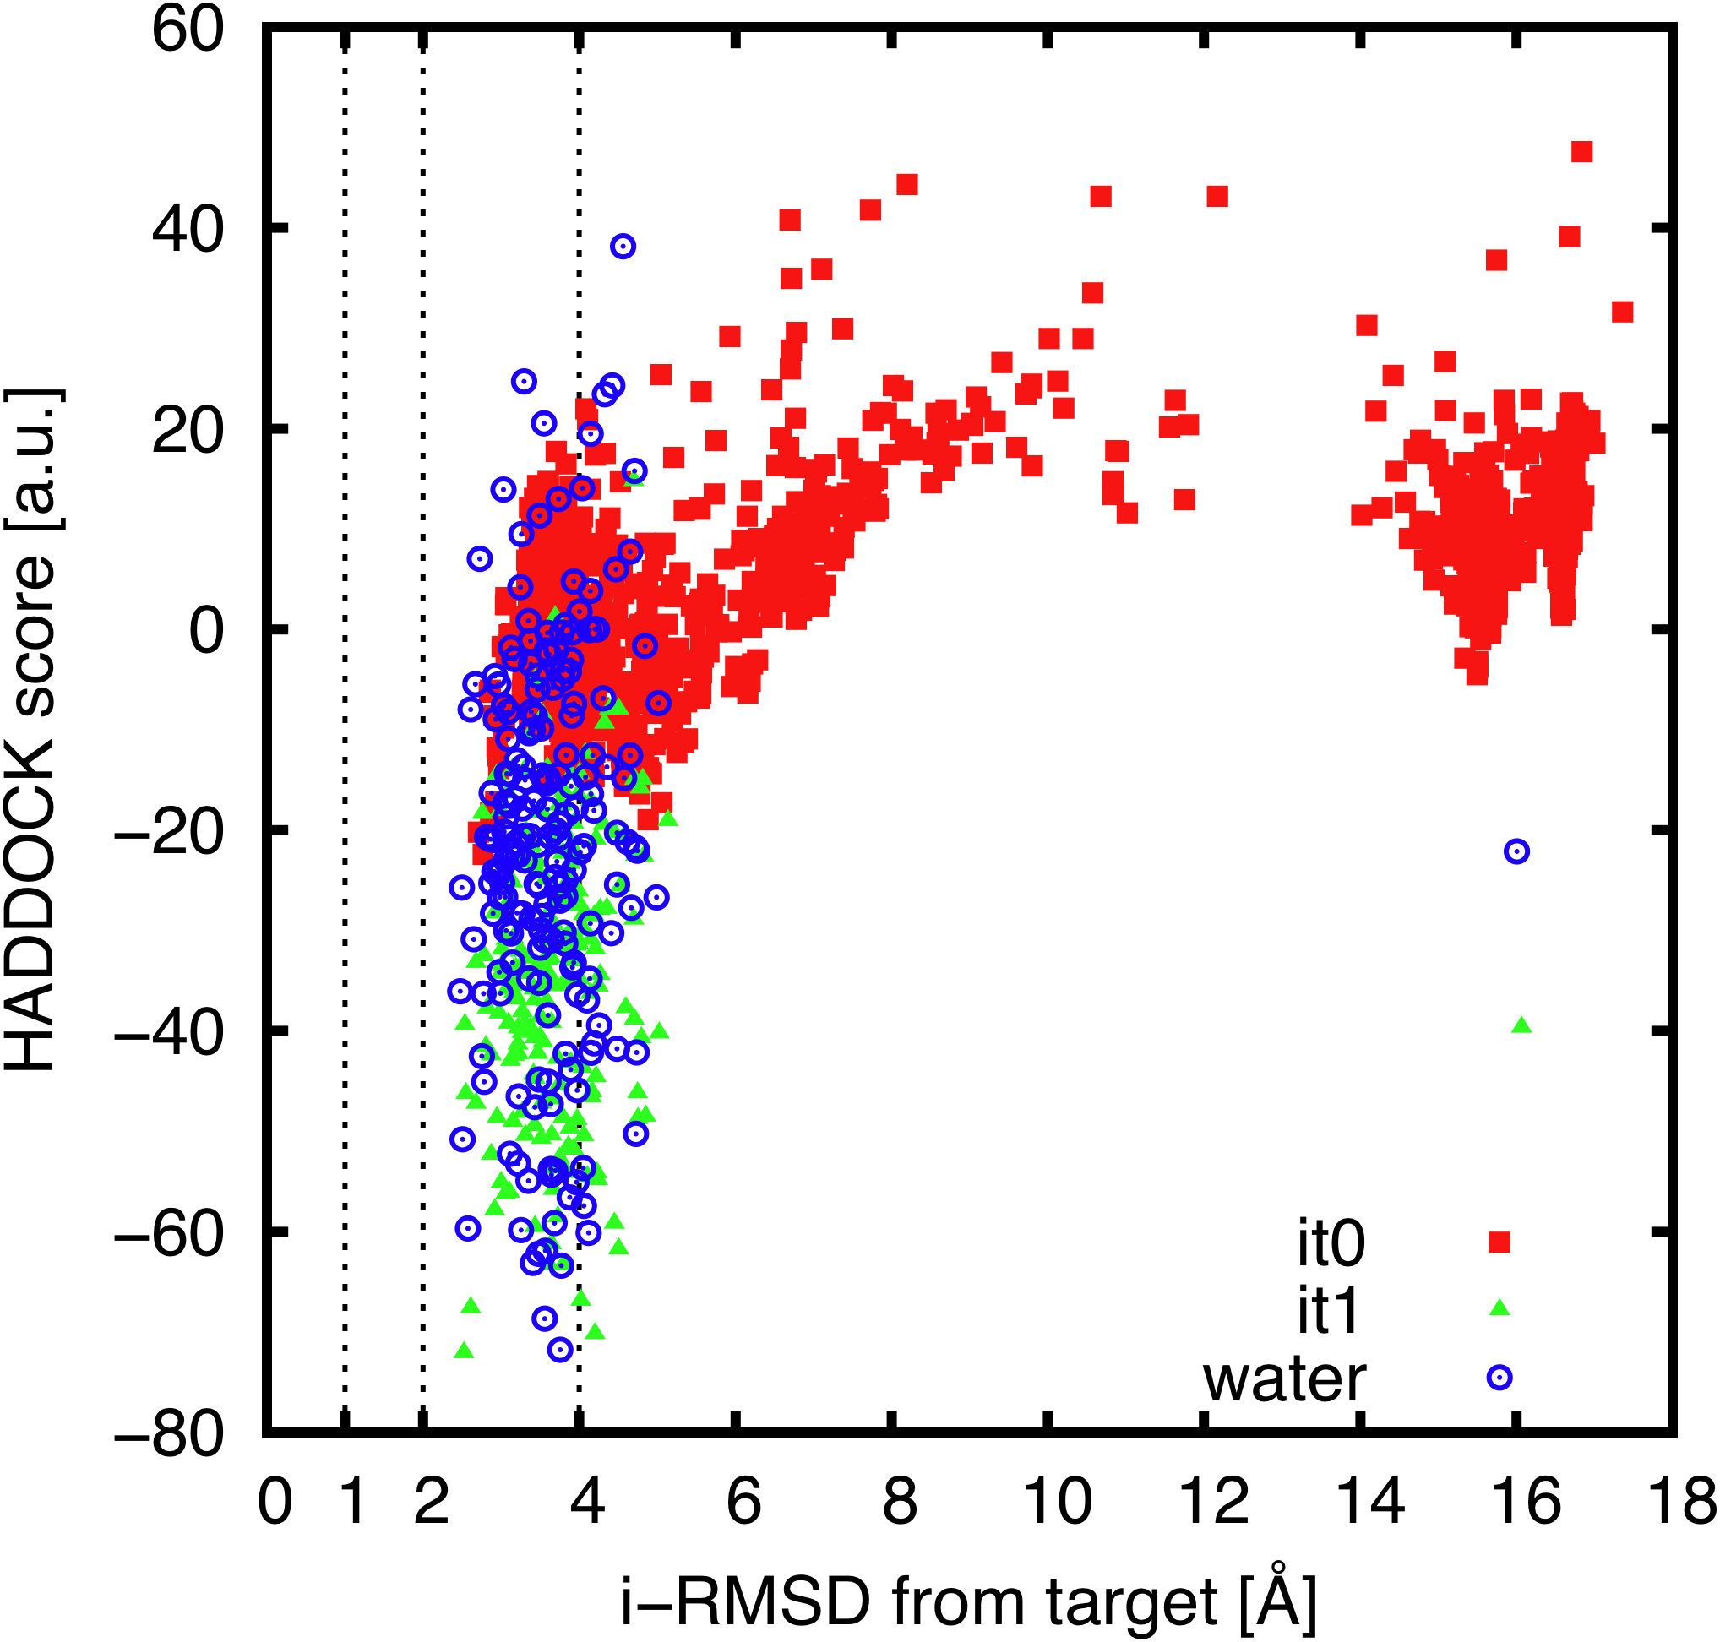
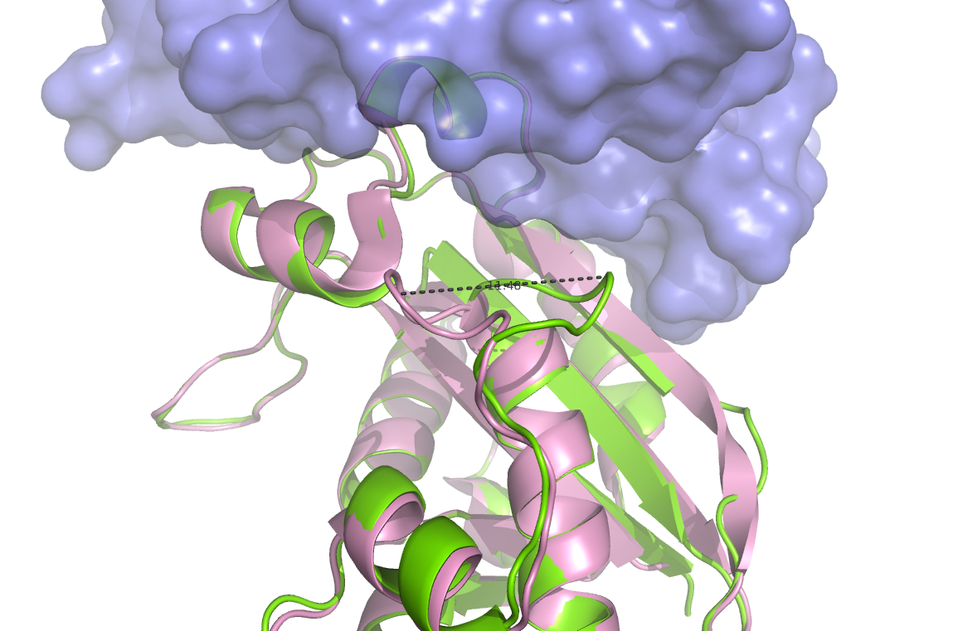
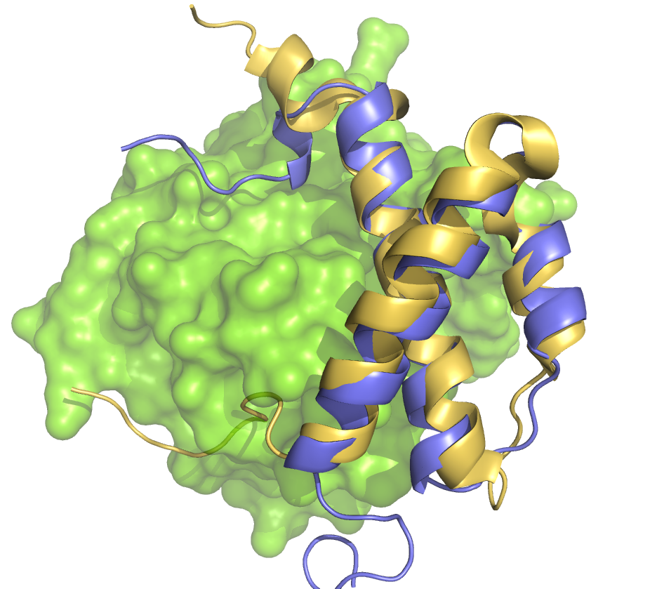
PCS-HADDOCK “synthetic” results: Unbound-unbound case
Unbound-unbound docking
ε (Xray unbound) vs ε (Xray bound)
with HOT (Xray bound)
HOT (NMR unbound) vs HOT (Xray bound)
with ε (Xray bound)
ε (Xray unbound): 1J53 Hamdan, S.; Carr, P. D.; Brown, S. E.; Ollis, D. L.; Dixon, N. E. Structure 2002, 10, 535.
HOT (NMR unbound): 1SE7 DeRose, E. F.; Kirby, T. W.; Mueller, G. A.; Chikova, A. K.; Schaaper, R. M.; London, R. E. Structure 2004, 12, 2221
And again… Realistic synthetic data:
Random variation of PCS (±0.15ppm)
Removal of some PCS

Slide 9
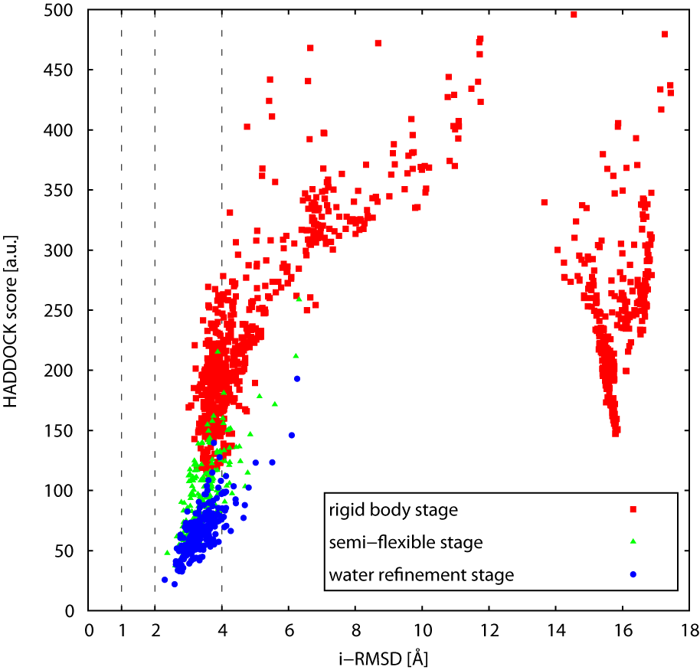
Real contribution of the PCS score?
PCS score [a.u.]

Slide 10
Conclusion on the “synthetic” runs
Noise resistant
Number of lanthanides?
Expected results between * and ***

Slide 11
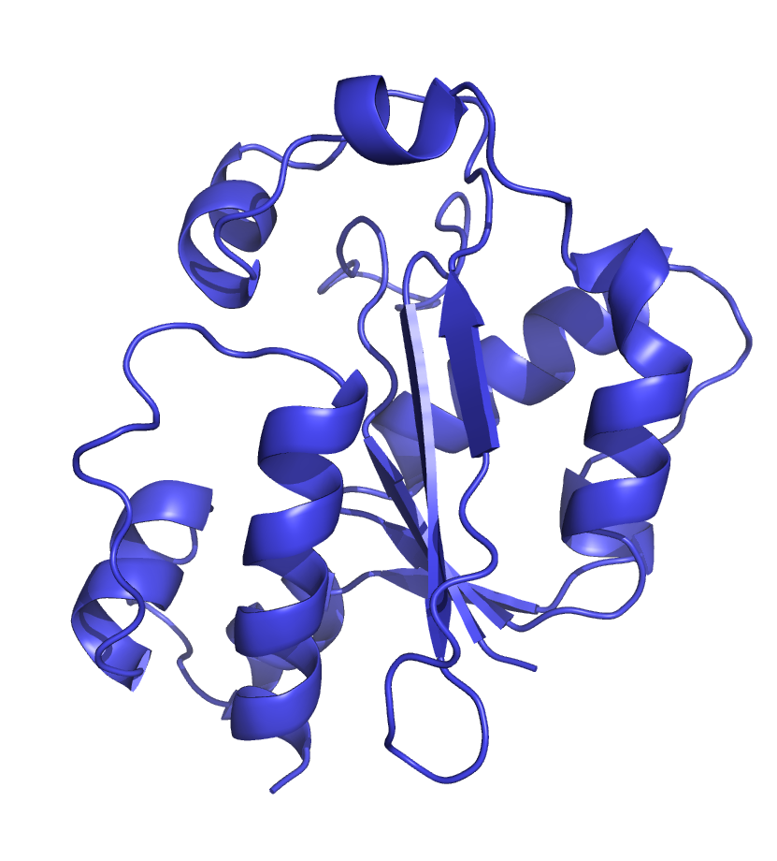
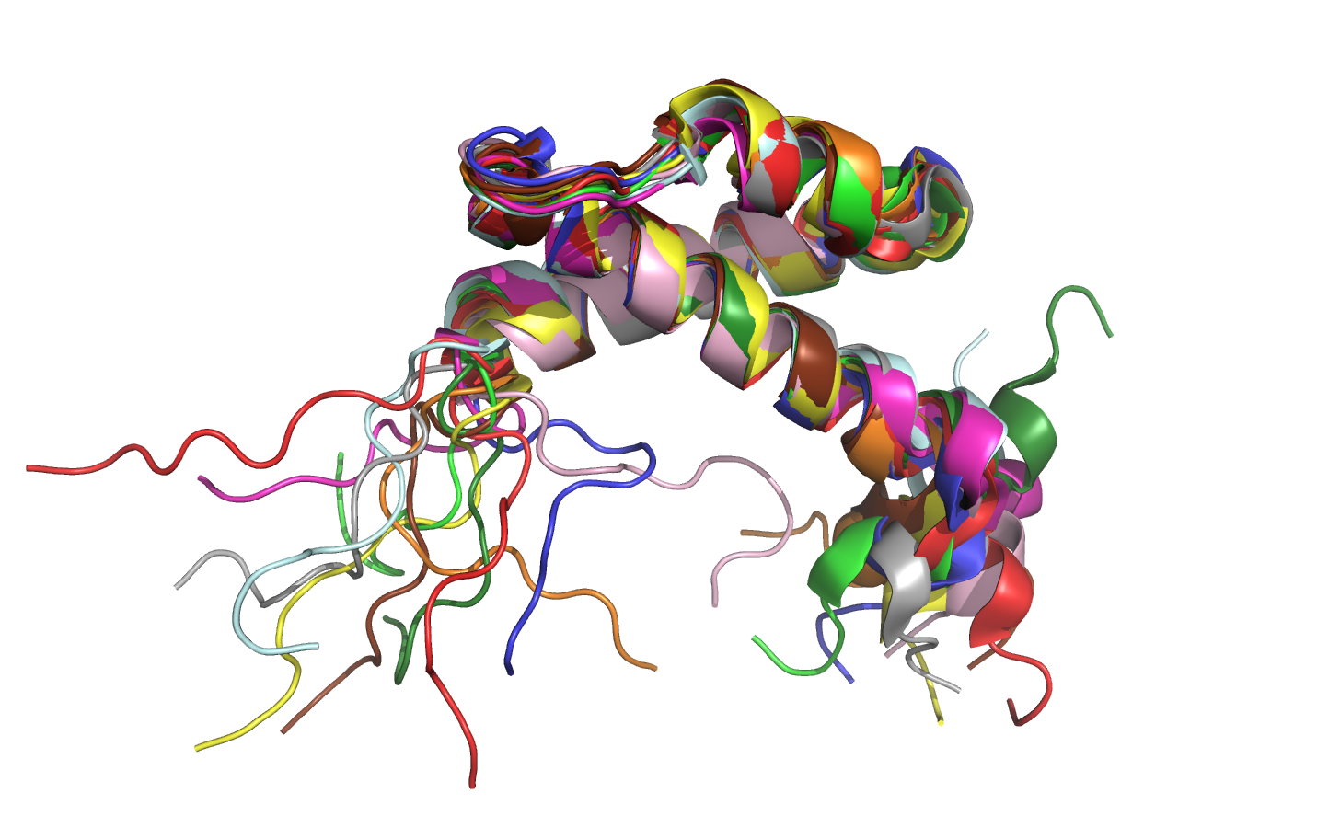
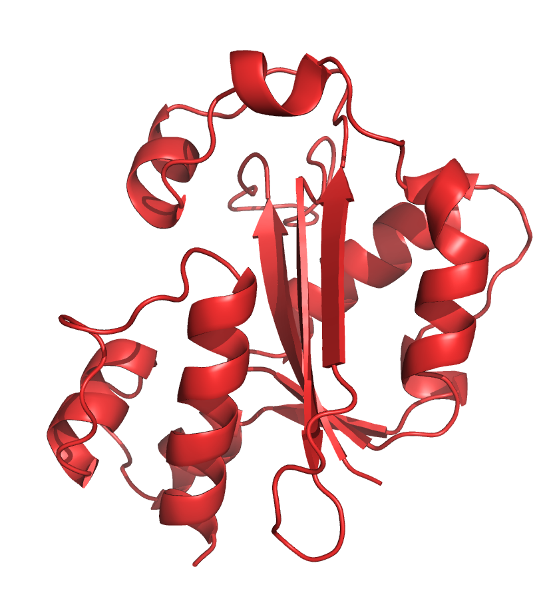
PCS-HADDOCK “real” case:
θ
?
ε
(14) Keniry, M. A.; Park, A. Y.; Owen, E. A.; Hamdan, S. M.; Pintacuda, G.; Otting, G.; Dixon, N. E. J. Bacteriol. 2006, 188, 4464.

Slide 12
PCS-HADDOCK “real” results
Only 1 cluster (in both cases)
Best 4 structures reveal better energy for bound ε:
Bsa ↗ 50%
Electrostatics ↘ 52%

Slide 13
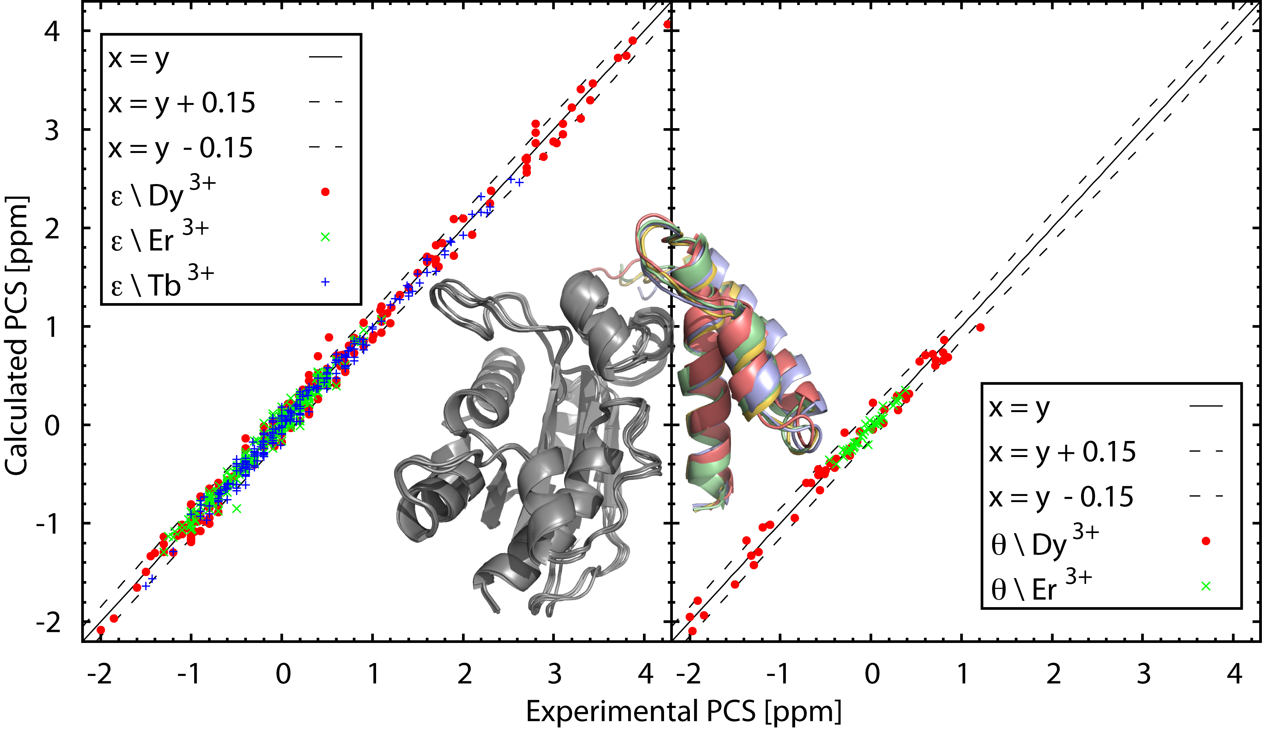
PCS-HADDOCK “real” results:

Slide 14
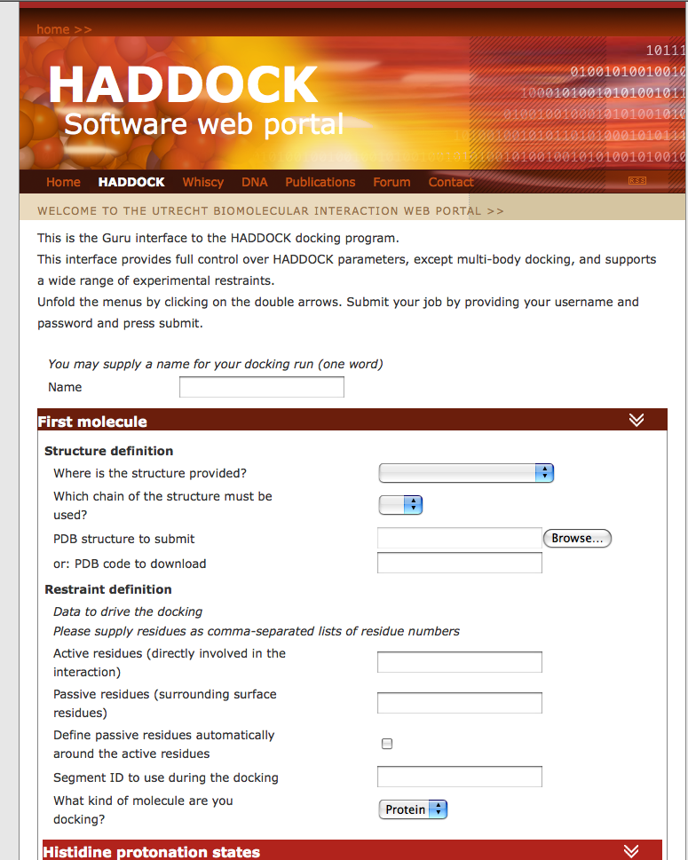
Perspectives
PCS gain popularity with paramagnetic tagging.
Need to go in the next update.

Slide 15
Thank u!
Prof. Alexandre Bonvin & HADDOCK team
Ezgi,
Adrien,
Panos,
Nuno,
Marc,
and everyone else of course.

