Slide 1
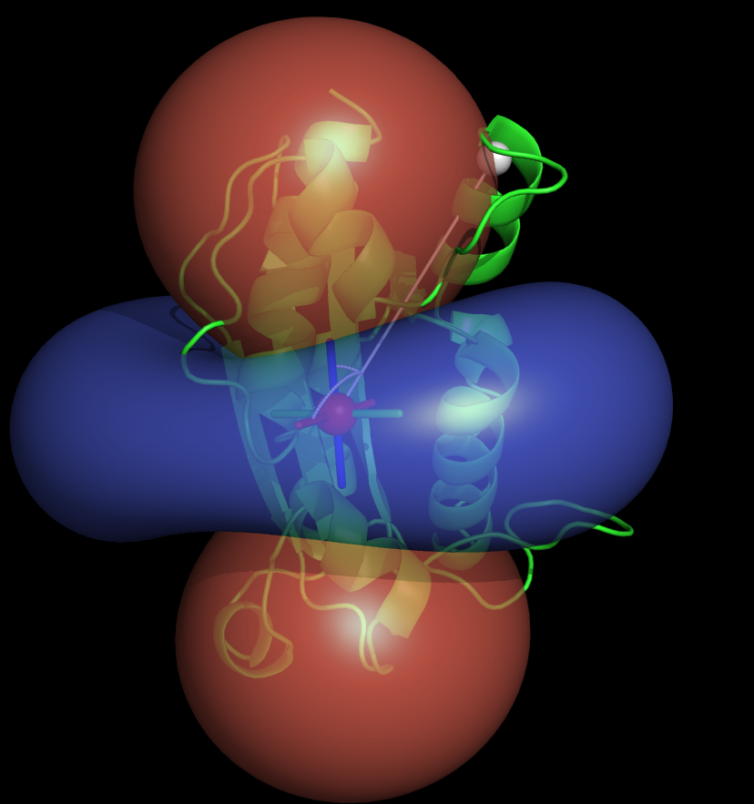
ECPM2009
Coffs Harbour
PCS + ROSETTA = NMR structure determination ?
Christophe Schmitz
Thomas Huber group
The University of Queensland

Slide 2
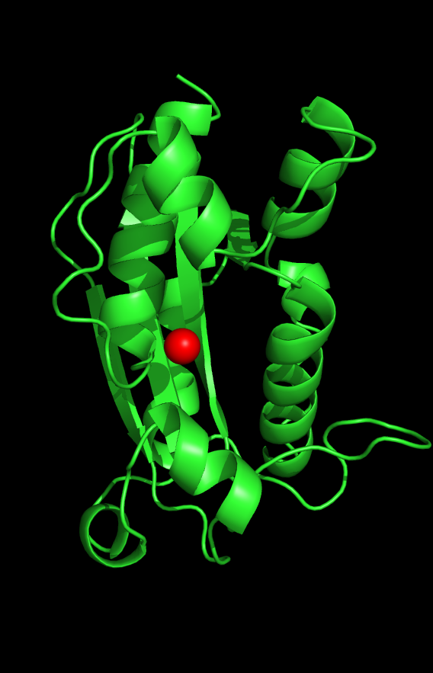

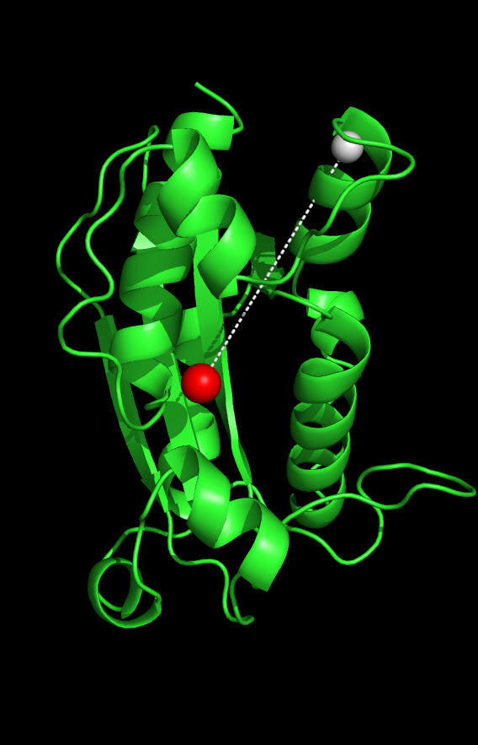
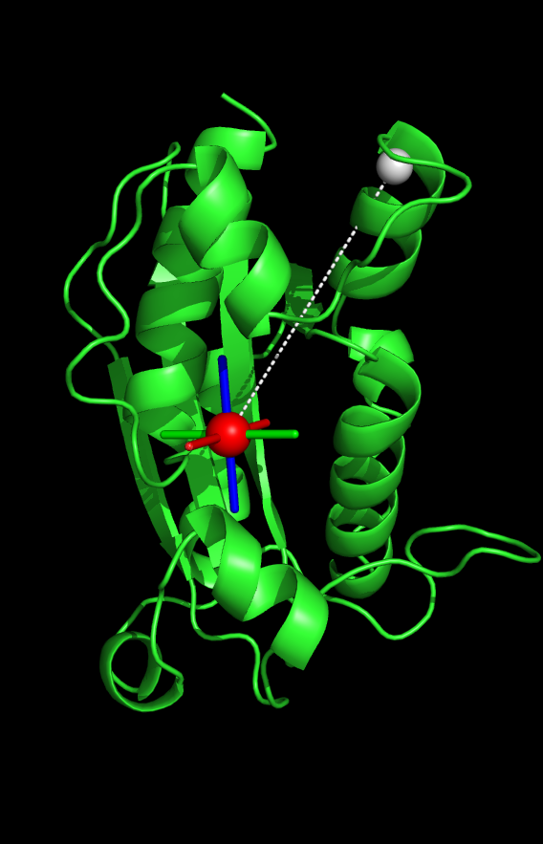
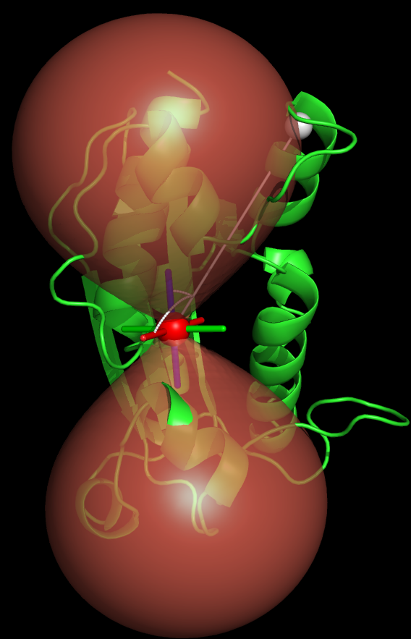
The Pseudocontact shift (PCS)
NMR effect induced by a paramagnetic lanthanide.
Measured on active spin (¹H, ¹⁵N, ¹³C…)
Long range effect.
Effect described within the Δχ-tensor.
Combine distance and angular dependence.
40 Å

Slide 3
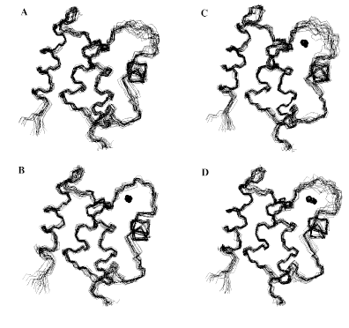
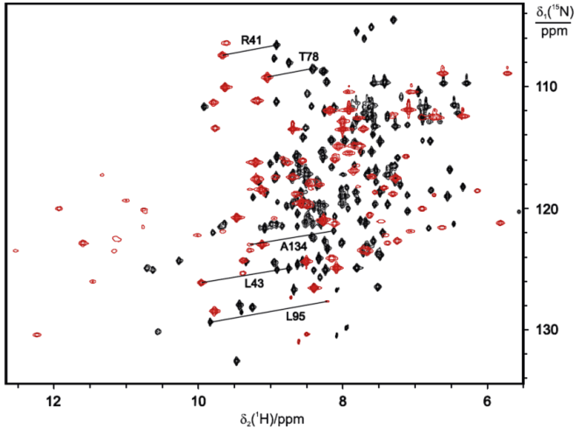
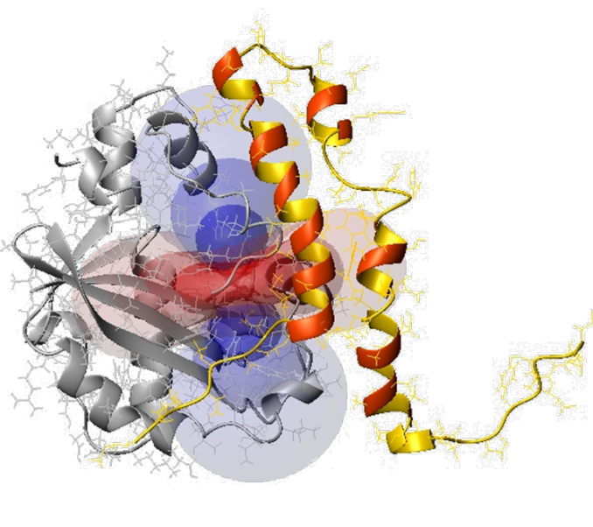
What is PCS used for?
Structure refinement
Chemical shift assignment
Protein-protein complex
Allegrozzi, M.; Bertini, I.; Janik, M. B. L.; Lee, Y. M.; Lin, G. H.; Luchinat, C. JACS 2000, 122, (17), 4154-4161.
Schmitz, C.; John, M.; Park, A. Y.; Dixon, N. E.; Otting, G.; Pintacuda, G.; Huber, T., JBNMR 2006, 35, 79-87.
Pintacuda, G.; Park, A. Y.; Keniry, M. A.; Dixon, N. E.; Otting, G. JACS 2006, 128, (11), 3696-3702.
What about structure determination?

Slide 4
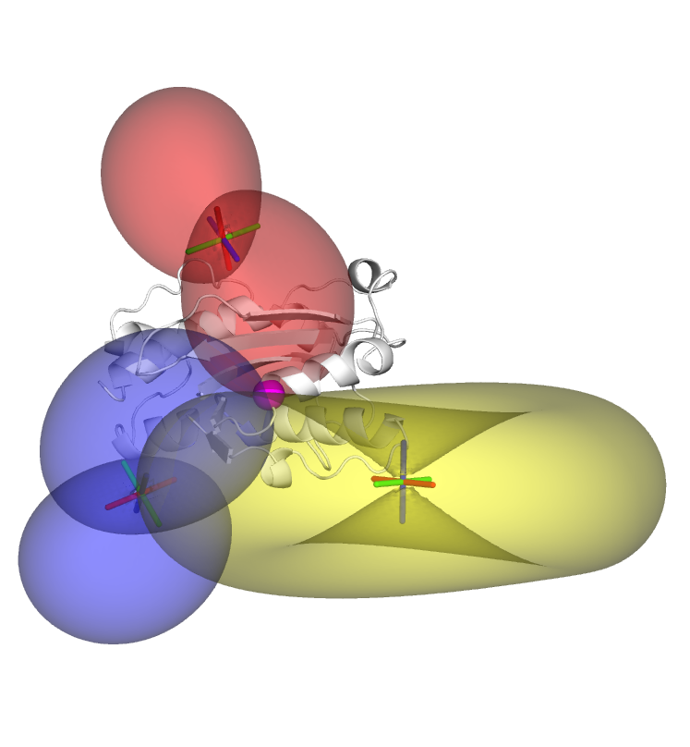
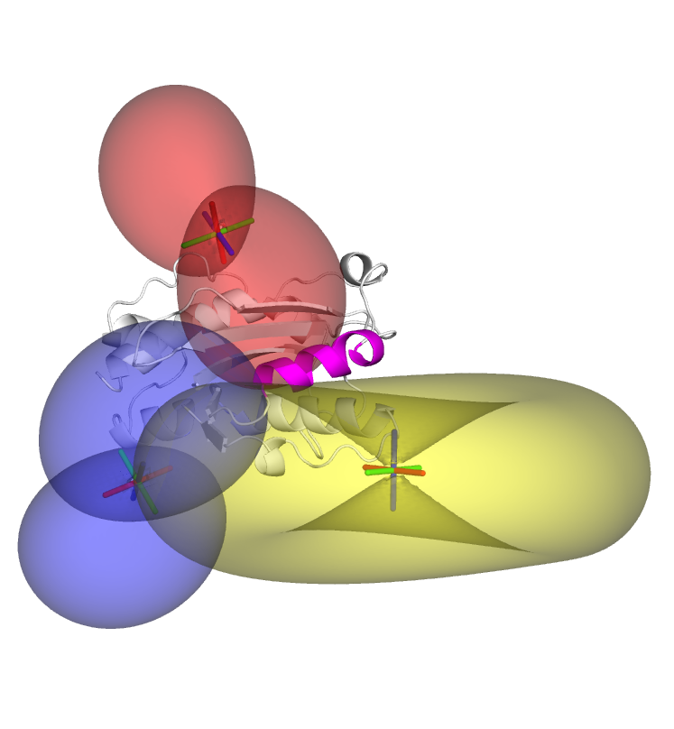
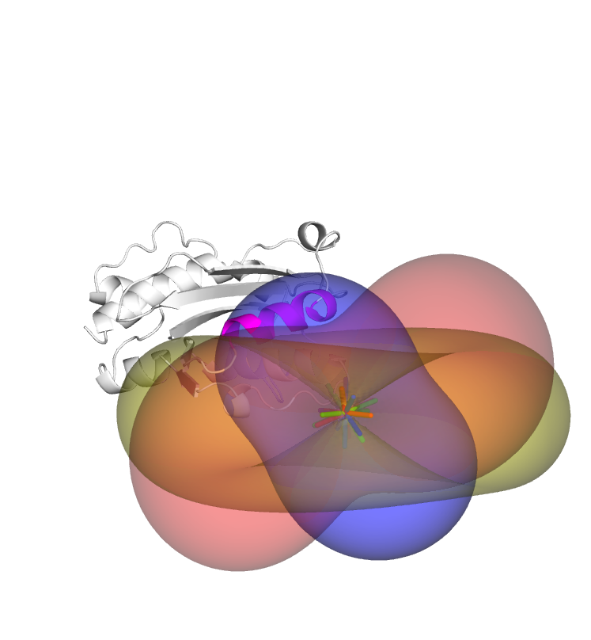

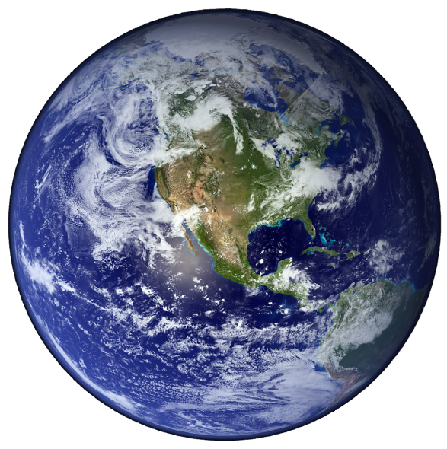
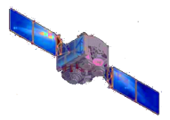
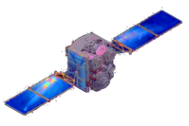
PCS for structure determination?

Slide 5

Rosetta for structure prediction
http://www.rosettacommons.org/software/index.html

Slide 6

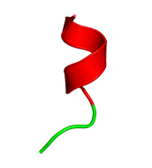

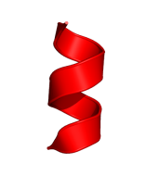
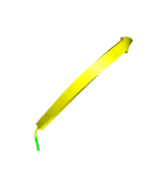
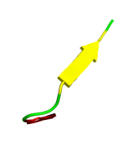
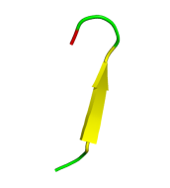
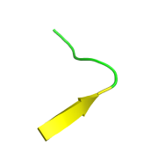
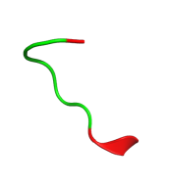
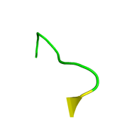
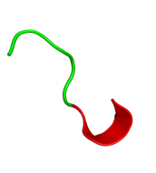
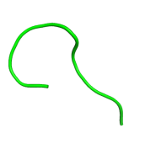
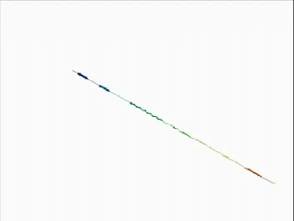
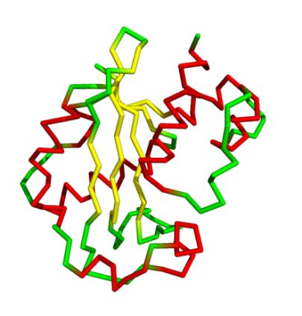
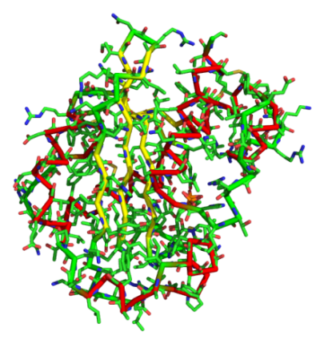
Rosetta structure prediction protocol
…GFMDYEFSL………….. RQIVLDTET…………..TGMNQIGAH…
Fragment picking
Abinitio
High resolution refinement

Slide 7
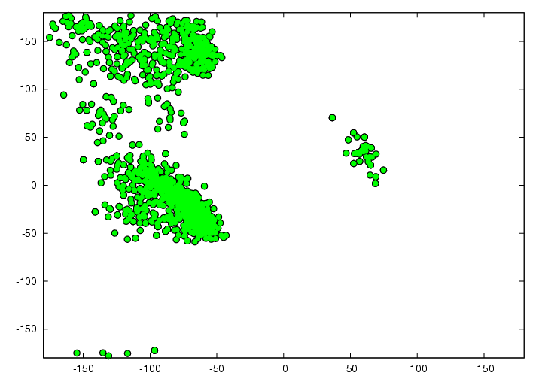
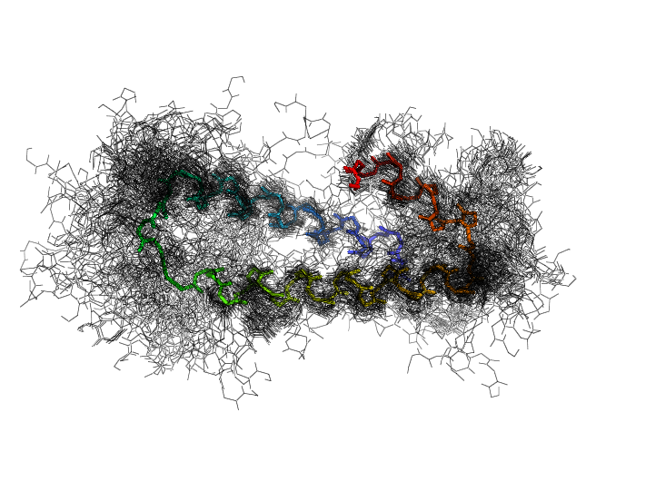
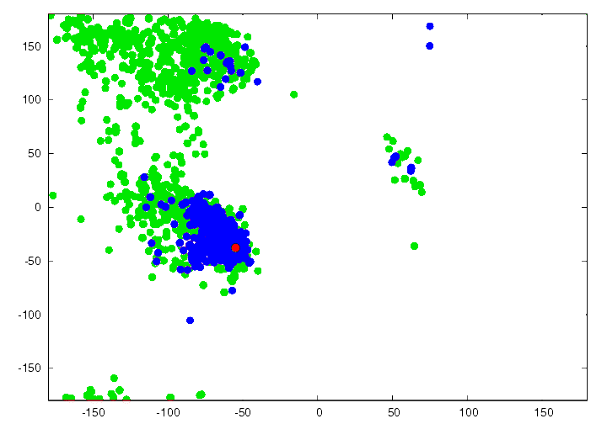
Fragment picking with CS-ROSETTA
Fragment picking
ψ
ϕ
• Rosetta Fragments
• CS-Rosetta Fragments
• Native fragment
ψ
Yang Shen, Oliver Lange, Frank Delaglio, et al.
PNAS, (2008) 105, 4685-4690
ϕ

Slide 8
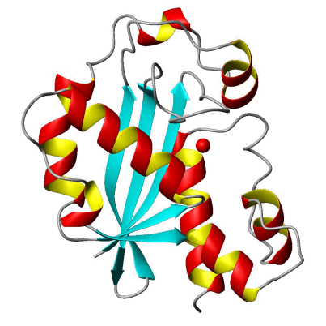
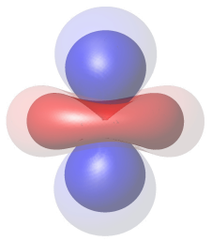
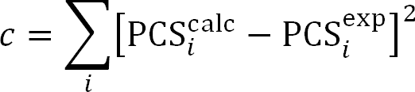
PCS into ROSETTA
Fragment picking
Abinitio
High resolution refinement

Slide 9
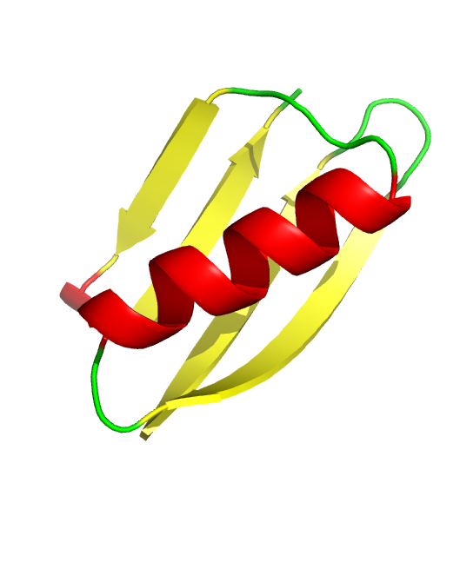
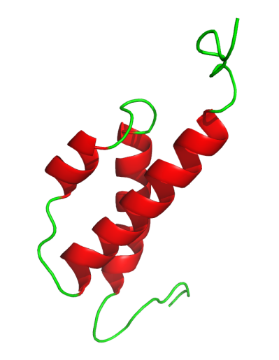
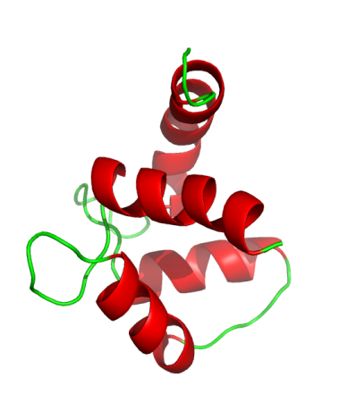
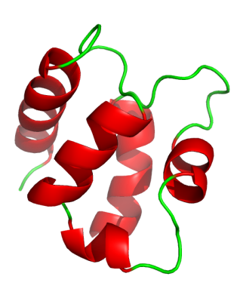
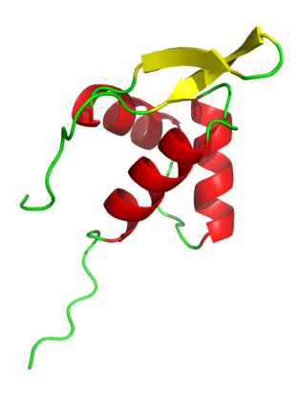
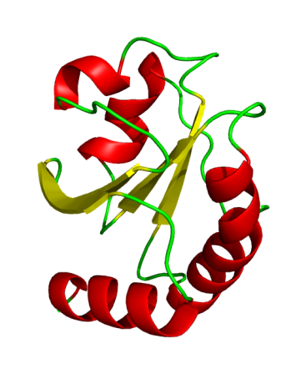
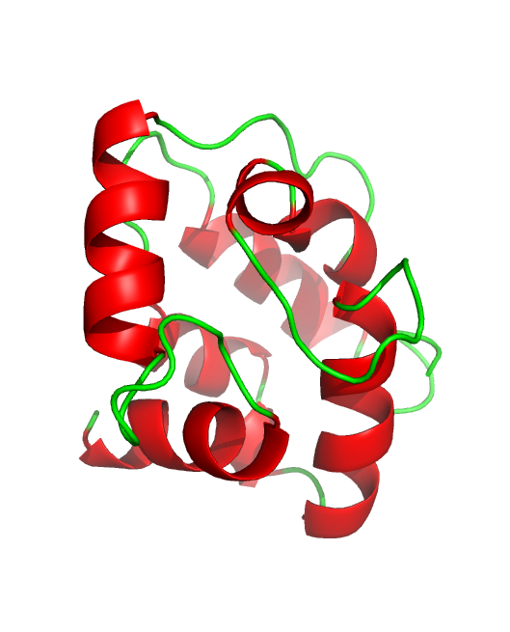
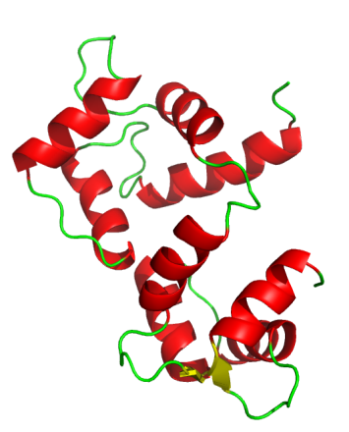
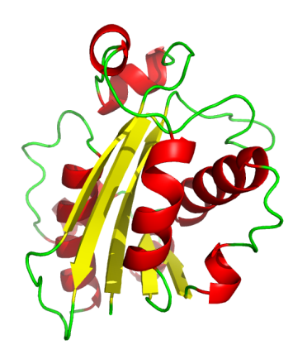
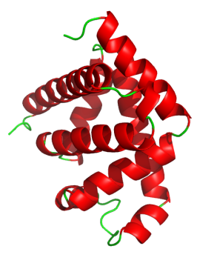
List of protein targets
3GB1
1KQV
2AE9
1AOY
1SW8
Protein G
56 residues
Calbindin
75 residues
θ subunit
76 residues
ArgN repressor
78 residues
N-t Calmodulin
79 residues
1XOA
1RJV
2K61
1BZR
1J54
Thioredoxin
108 residues
Parvalbumin
110 residues
Calmodulin
146 residues
Myoglobin
153 residues
ε subunit
186 residues

Slide 10
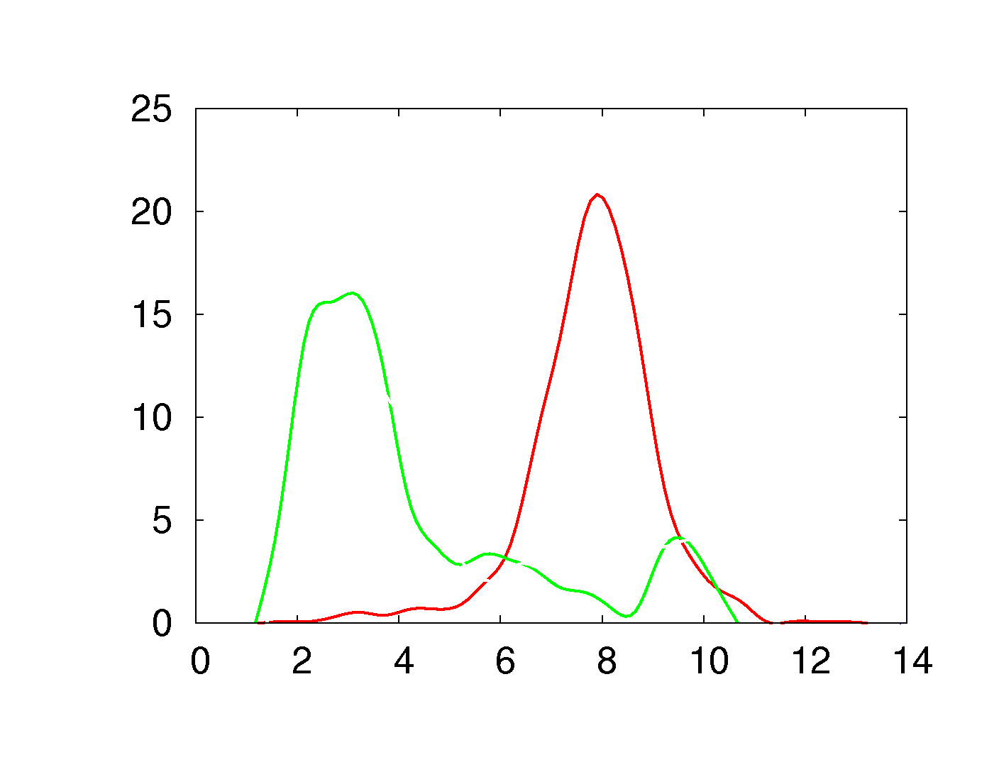

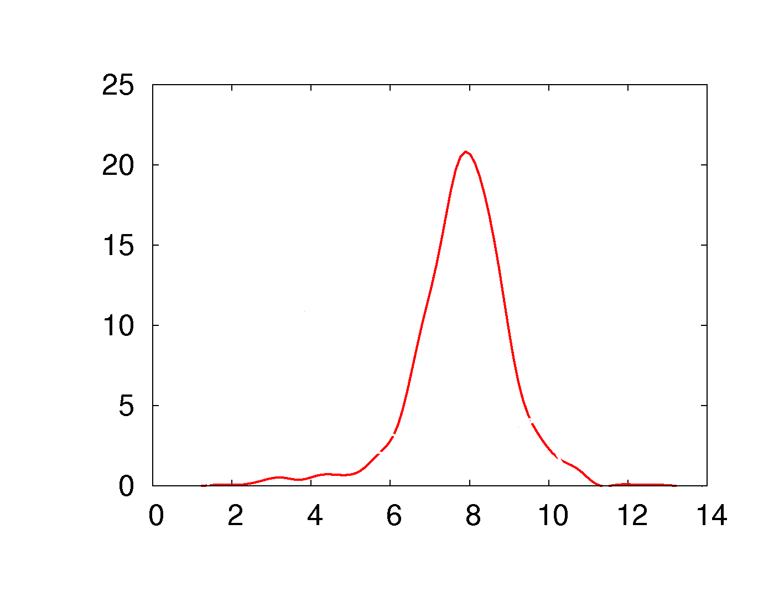
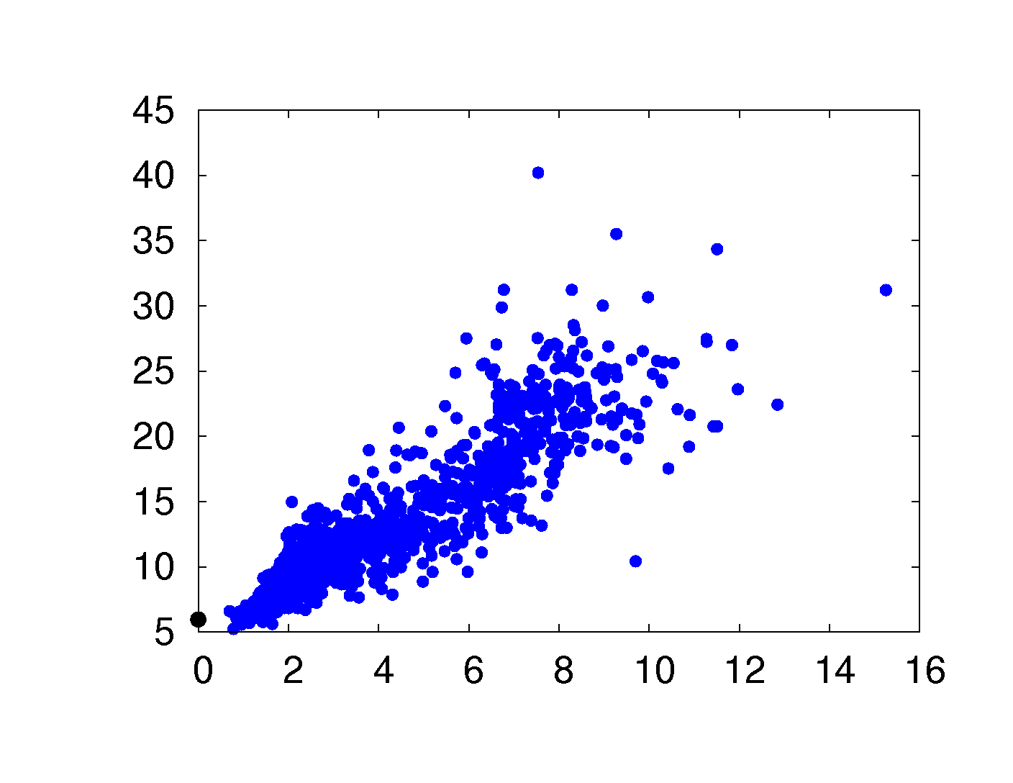
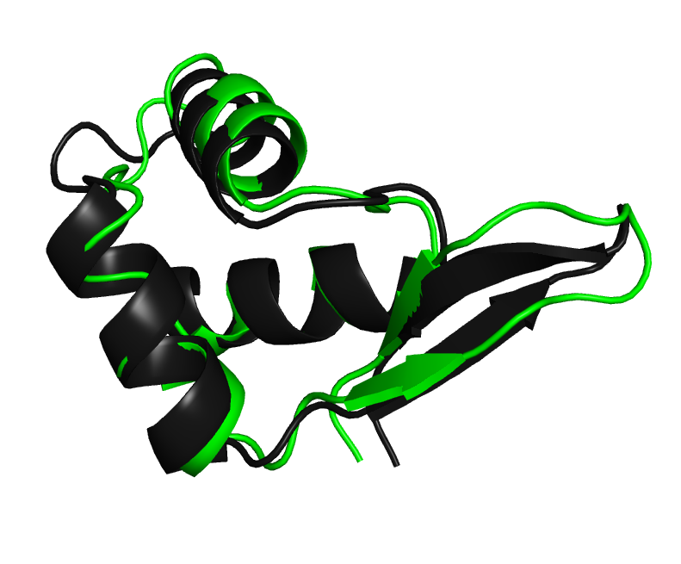
Example 1
- ROSETTA only
- PCS only
1AOY
- PCS-ROSETTA
Density
3 PCS data sets
N and H
ArgN repressor
78 residues
Cα RMSD
• 1000 decoys from low to high RMSD
• Native structure
PCS SCORE
Cα RMSD
■ Native ■ Best PCS-ROSETTA decoy

Slide 11
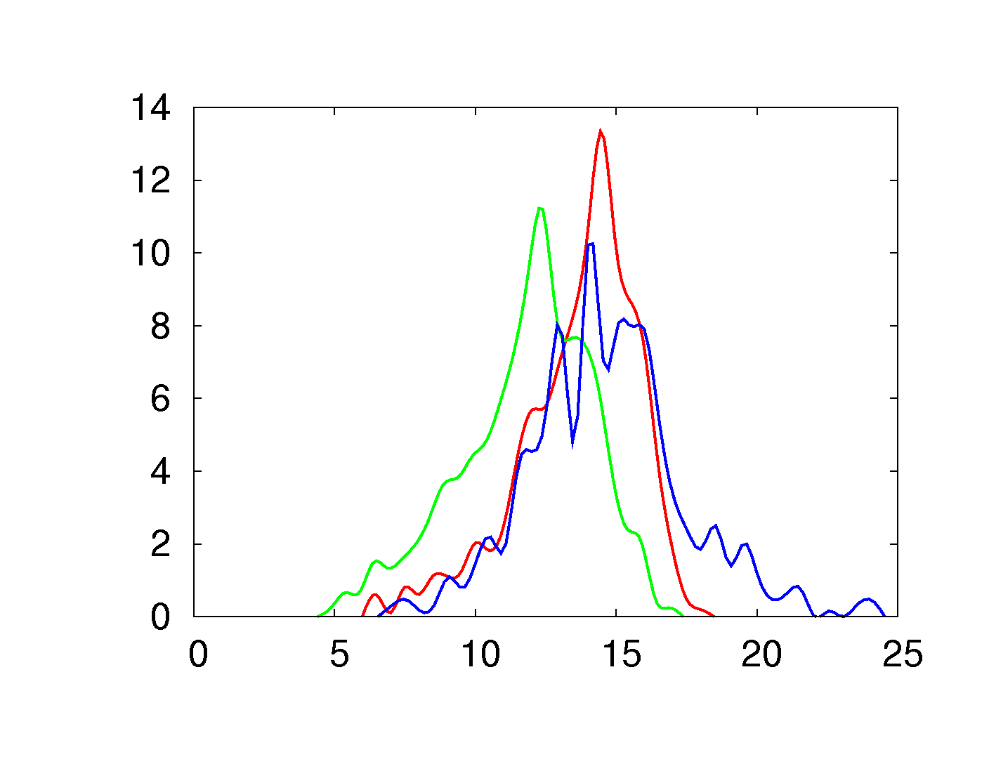
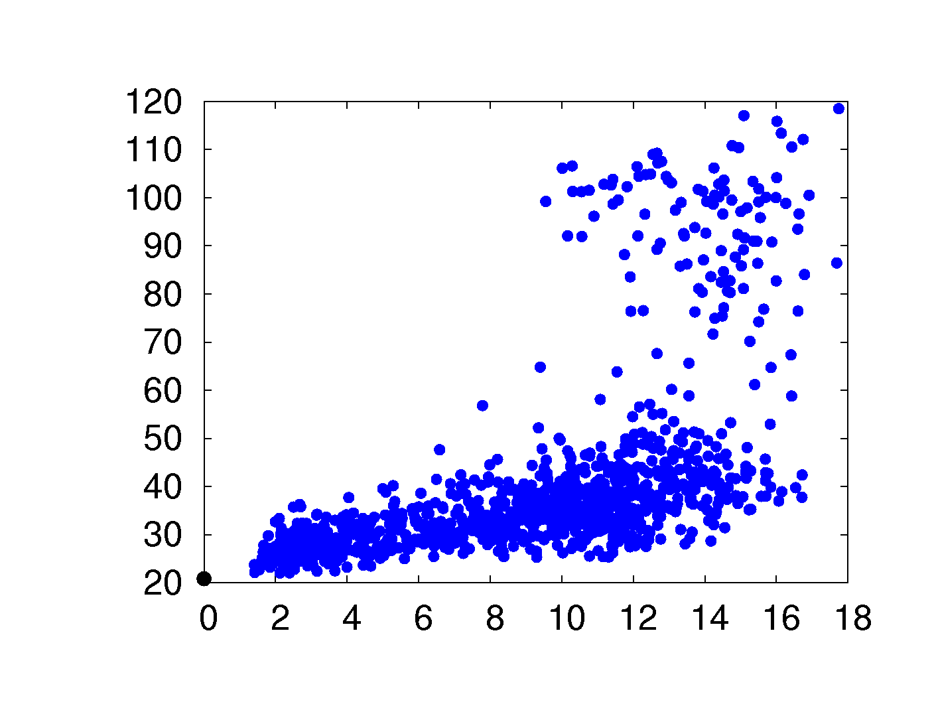
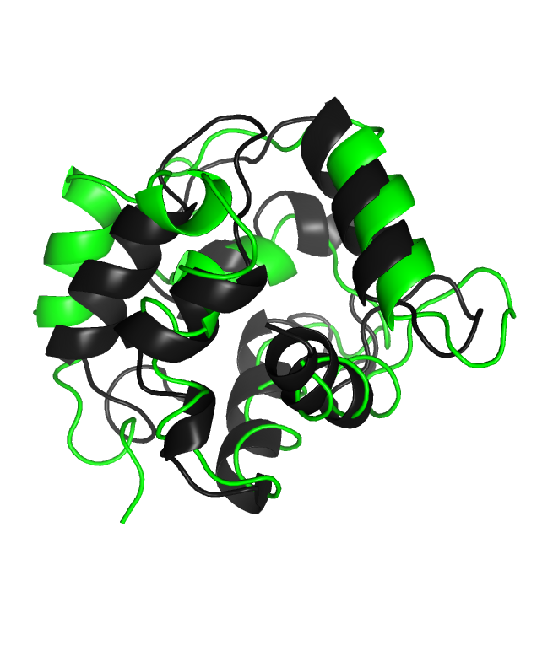
Example 2 (it doesn’t work well, but we sort of know why)
- ROSETTA only
- PCS only
1RJV
- PCS-ROSETTA
Density
1 PCS data sets
H
Parvalbumin
110 residues
Cα RMSD
• 1000 decoys from low to high RMSD
• Native structure
PCS SCORE
Cα RMSD
■ Native ■ Best PCS-ROSETTA decoy

Slide 12



Example 3 (it works and it’s cool because it’s a big one)
- ROSETTA only
- PCS only
- PCS-ROSETTA
2K61
Density
4 PCS data sets
H
Calmodulin
146 residues
Cα RMSD
• 1000 decoys from low to high RMSD
• Native structure
PCS SCORE
Cα RMSD
■ Native ■ Best PCS-ROSETTA decoy

Slide 13


Example 5 (it doesn't' work yet, but it really should, and we are going to keep working hard on that one)
- ROSETTA only
- PCS only
- PCS-ROSETTA
1J54
Density
5 PCS data sets
C, N and H
ε subunit
186 residues
Cα RMSD
PCS SCORE
Coming soon…
• 1000 decoys from low to high RMSD
• Native structure
Cα RMSD

Slide 14
List of protein targets
3GB1
1KQV
2AE9
1AOY
1SW8
3
11
2
3
2
Protein G
56 residues
Calbindin
75 residues
Theta
76 residues
ArgN repressor
78 residues
N-t Calmodulin
79 residues
1XOA
1RJV
2K61
1BZR
1J54
1
1
4
2
5
Thioredoxin
108 residues
Parvalbumin
110 residues
Calmodulin
146 residues
Myoglobin
153 residues
ε subunit
186 residues

Slide 15







Conclusion
1. New road for structure determination
2. PCS and Rosetta work hand in hand
3. PCS are awesome

Slide 16











Acknowledgments
Dr Michael John (GAU)
Prof. David Baker (UW)
Dr Guido Pintacuda
(ENS-Lyon)
Robert Vernon (UW)
Prof. Gottfried Otting (ANU)
Dr Thomas Huber (UQ)
GSRTG
Dr Xun-Cheng Su (ANU)

Slide 17

Different paramagnetic lanthanides…

Slide 18



Example 4: it works and it’s a good surprise because we thought it wouldn’t.
- ROSETTA only
- PCS only
- PCS-ROSETTA
2AE9
2 PCS data sets
H
Density
θ subunit
76 residues
■ θ ■ ε
Cα RMSD
PCS SCORE
• 1000 decoys from low to high RMSD
• Native structure
Cα RMSD

Slide 19


1KQV
- ROSETTA only
- PCS only
- PCS-ROSETTA
Density
11 PCS data sets
C, N and H
Calbindin
75 residues
Cα RMSD
PCS SCORE
• 1000 decoys from low to high RMSD
• Native structure
Cα RMSD

Slide 20


3GB1
- ROSETTA only
- PCS only
- PCS-ROSETTA
Density
3 PCS data sets
H
Protein G
56 residues
Cα RMSD
• 1000 decoys from low to high RMSD
• Native structure
PCS SCORE
Cα RMSD

Slide 21


- ROSETTA only
- PCS only
- PCS-ROSETTA
1XOA
Density
1 PCS data sets
H and N
Thioredoxin
108 residues
Cα RMSD
PCS SCORE
• 1000 decoys from low to high RMSD
• Native structure
Cα RMSD

Slide 22


1BZR
- ROSETTA only
- PCS only
- PCS-ROSETTA
Density
2 PCS data sets
H
Myoglobin
153 residues
Cα RMSD
PCS SCORE
• 1000 decoys from low to high RMSD
• Native structure
Cα RMSD

Slide 23

PCS into ROSETTA
Fragment picking
Abinitio
High resolution refinement

